Slide 1
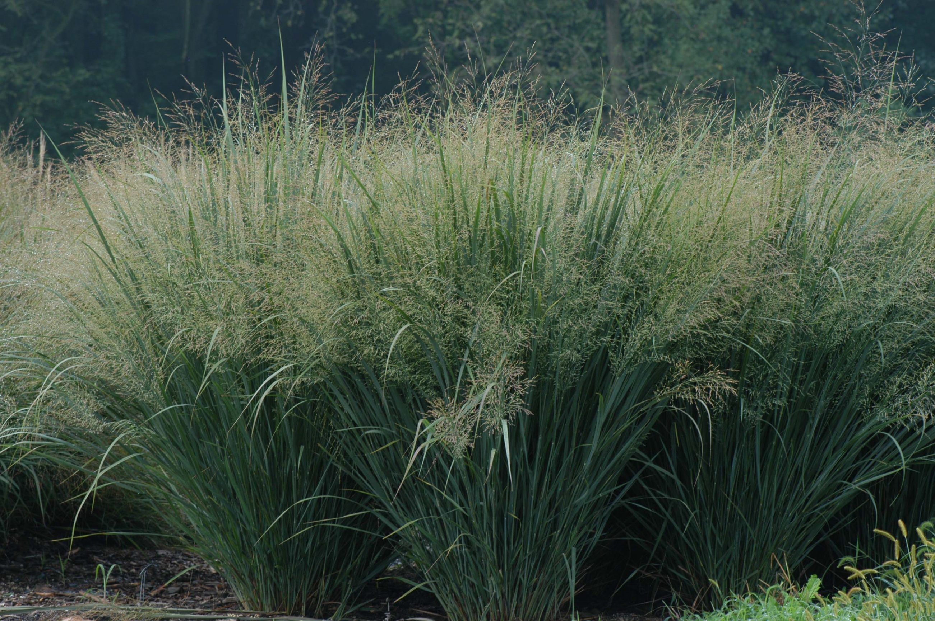
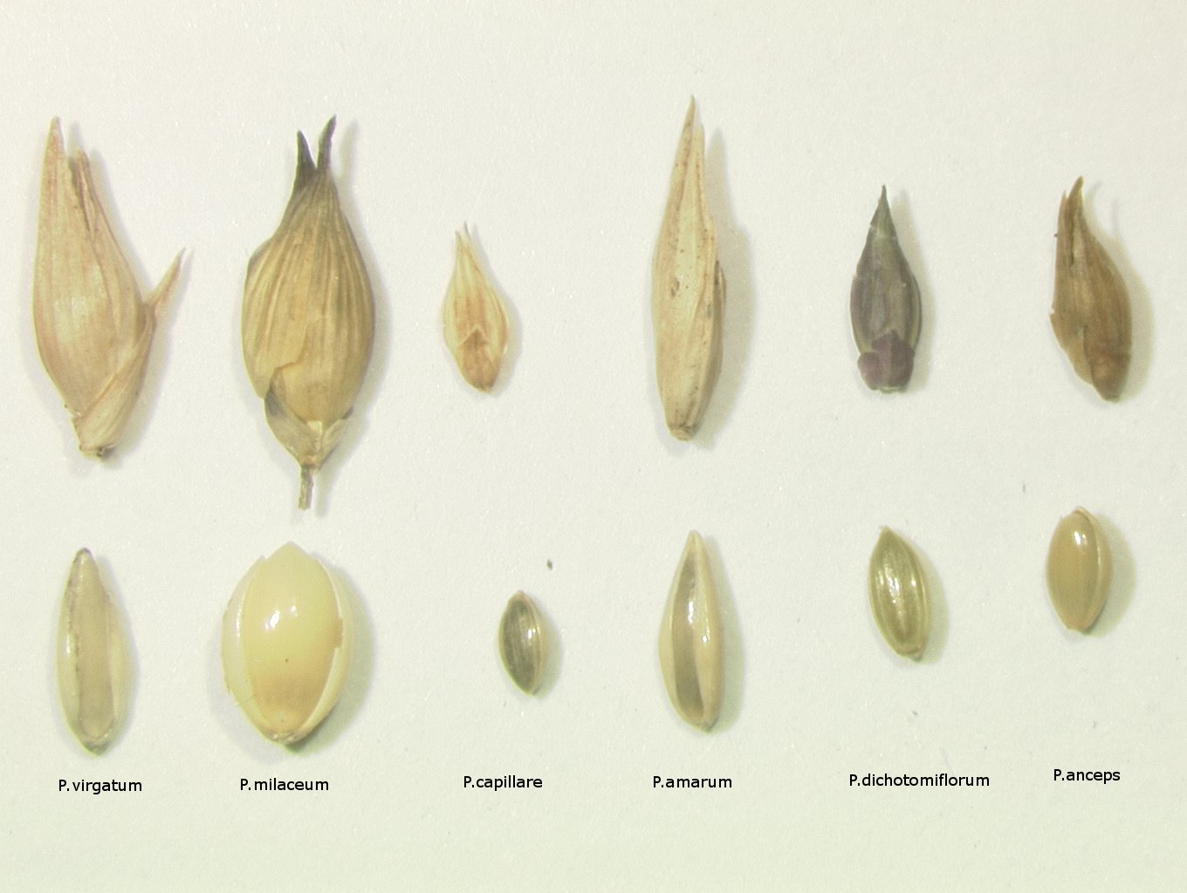
Ecological Risk Assessment of Switchgrass (Panicum virgatum) in Connecticut
Geoffrey Ecker and Carol Auer Department of Plant Science, University of Connecticut
Introduction
Figure 1: Low Input Biofuel Crop?
Figure 2: Flowering
A native of North America, switchgrass (Panicum virgatum) is a hardy rhizomatous perennial with an expansive range. The U.S. Department of Energy has identified switchgrass as a promising biofuel crop for low-input agriculture and marginal lands (Fig. 1). This has prompted research on improvement through genetic modification (GM). Before any new GM crop can be released, regulators must evaluate not only the modified plants, but also potential negative impacts to the environment. For example, hybridization between closely-related species could result in the transfer of GM traits to relatives (gene flow) creating new weeds or invasives. The objective of this research program is to assess the potential for gene flow and ecological risks from the future release of GM switchgrasses in New England.
Distribution and Gene Flow
A review of published floras and approximately 2000 herbarium specimens at the University of Connecticut and Yale University revealed ten species of Panicum in Connecticut (Table 1). The study of herbarium specimens provided preliminary information about the geographical distribution of switchgrass and its relatives. Nine of the ten Panicum are native, with P. miliaceum introduced from China. Four Panicum species are listed as threatened or of special concern in New England states. New England's Panicum species flower during roughly the same period from July-September (Figure 2). The potential for hybridization (gene flow) between these ten Panicum species is unknown. However, the complete picture of gene flow may be even more complex due to the genus Dichanthelium. Grasses in the Dichanthelium genus were previously classified as a sub-genus of Panicum, but they are now recognized as a separate genus. Research shows that there are twenty-two Dichanthelium species in Connecticut and these plants exhibit a complex pattern of flowering that will affect the potential for gene flow between genera (Figure 2). Dichanthelium has two flowering periods. The primary flowering period is characterized by open pollination and occurs during the spring and early summer. The second flowering period is characterized by cleistogamous flowers, which are generally enclosed in sheaths and unlikely to form hybrids. At present, there is no direct evidence regarding the potential for gene flow between switchgrass and Dichanthelium.
www.envisioninggreen.com
Table 1: Panicum in New England
Figure 3: Identification
Panicum species in Connecticut | Common Name(s) | Native in CT? | CT Distribution (%Towns) | Hybridization w/ P. virgatum? | State listed species?
P. virgatum | Switch Grass | Native | 20% | - | -
P. miliaceum | Proso Millet | Introduced | 6% | Unknown | -
P.capillare | Witchgrass | Native | 22% | Hybridizes with P.philadelphicum | -
P. philadelphicum | Philadelphia Witchgrass | Native | 11% | Hybridizes with P. capillare | MA
P. dichotomiflorum | Fall Panicum | Native | 19% | Unknown | -
P. amarum | Bitter Beachgrass | Native | 5% | Intergrades with P. virgatum | CT
P. rigidulum | Redtop Panicum | Native | 4% | Unknown | CT, MA,NY
P. anceps | Beaked Panicgrass | Native | No herbarium specimens | Unknown | -
P. verrucosum | Warty Panicgrass | Native | 1% | Unknown | CT
P. flexile | Wiry Witchgrass | Native | No herbarium specimens | Unknown | -
Spikelet
Future Work
These results support future projects including a botanical survey that will characterize the biogeography of switchgrass and its relatives. The botanical survey will also describe the plant communities associated with Panicum and Dichanthelium and their relationship with environmental gradients, such as salt exposure, site disturbance, and canopy cover. Because these grasses can be difficult to identify, a field guide to the genera will be produced. Figure 3 shows a comparison of Panicum seeds and spikelets. A detailed understanding of switchgrass gene flow and biogeography will create a solid basis for ecological risk assessment for future GM switchgrasses. This research is supported by a USDA Biotechnology Risk Assessment Grant and the University of Connecticut.
Seed

