Slide 1
COUNTERING STRYKER’S PUNCH
Cultural Heritage Imaging Professionals Conference Stanford University Palo Alto, CA July 10-12, 2017
Michael J. Bennett Head of Digital Imaging and Conservation University of Connecticut Library Storrs, CT

Slide 2
The visual record left behind by the Farm Security Administration (FSA) photographers has, according to New York Times critic Charles Hagen, come to “represent one of the most ambitious attempts ever made to depict a society in photographs.”

Slide 3
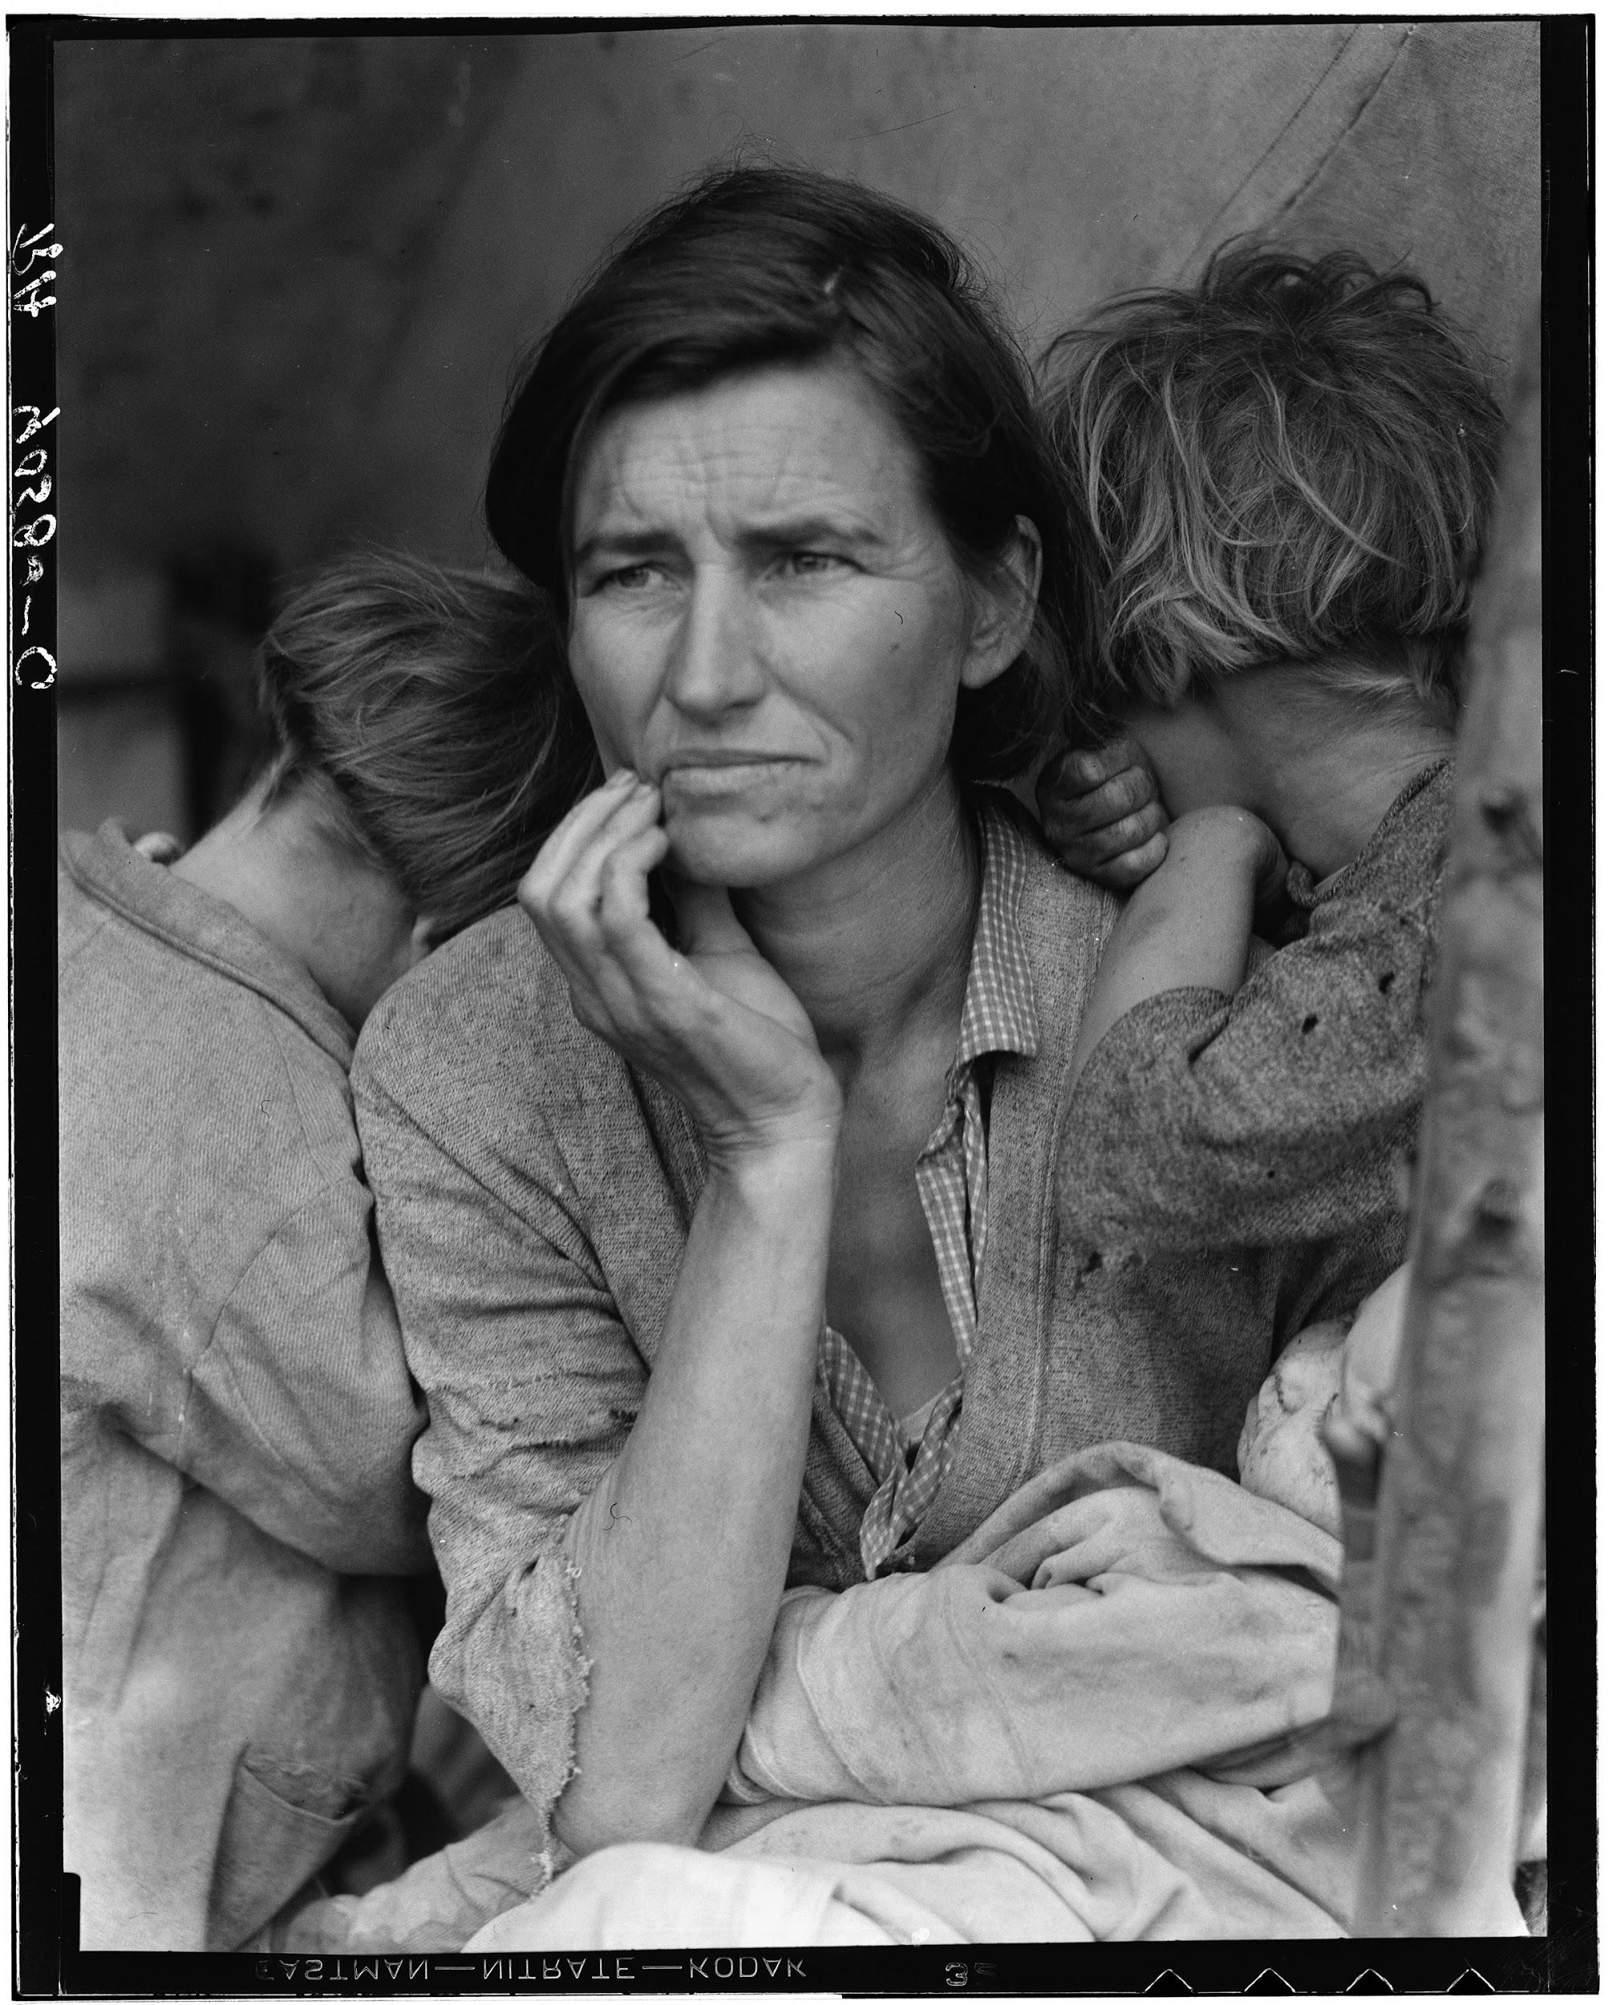

Slide 4
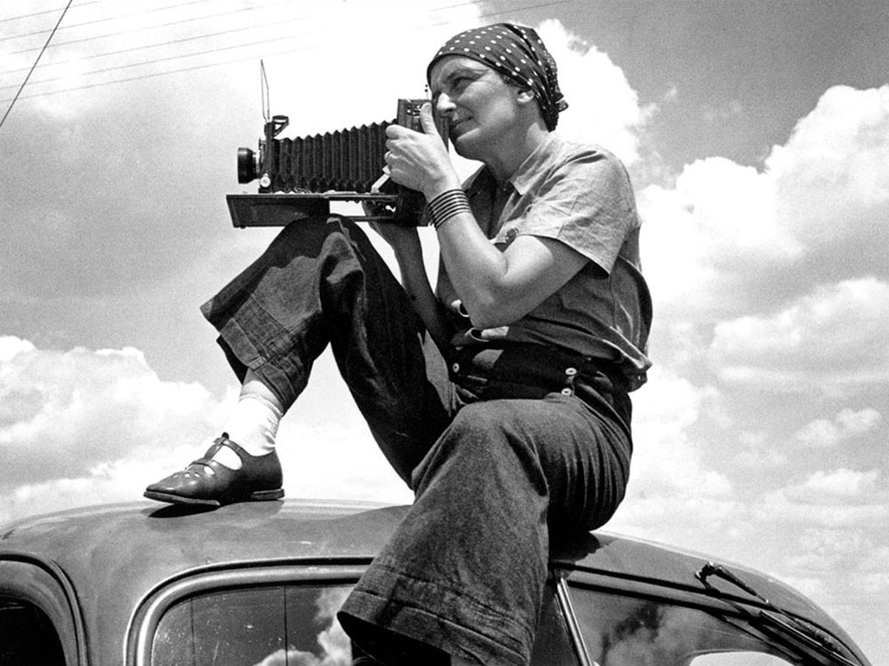
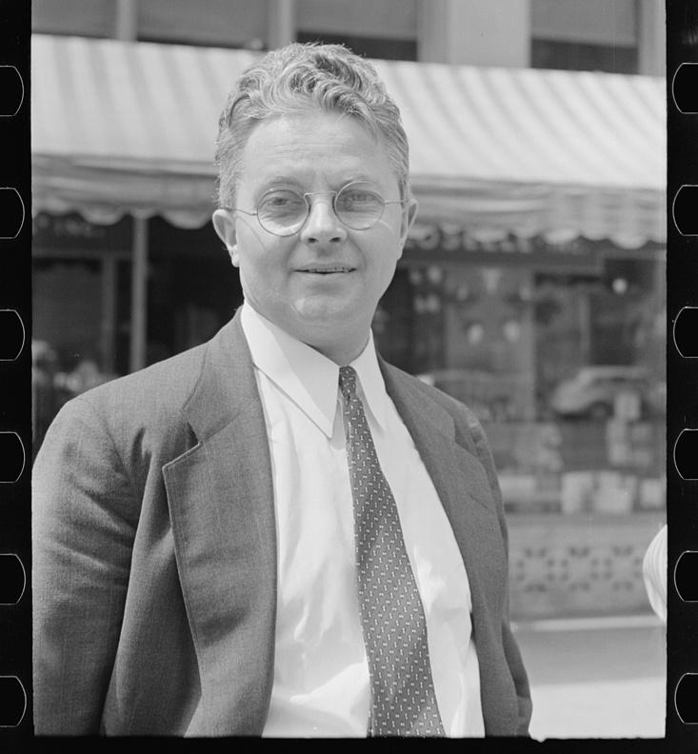
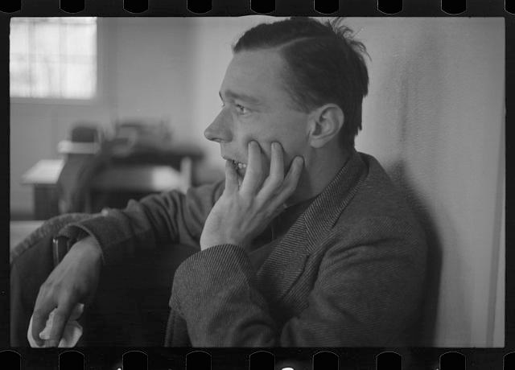
Dorothea Lange
Roy Stryker Head of Information Division of the U.S. Farm Security Administration 1935-1941
Walker Evans

Slide 5
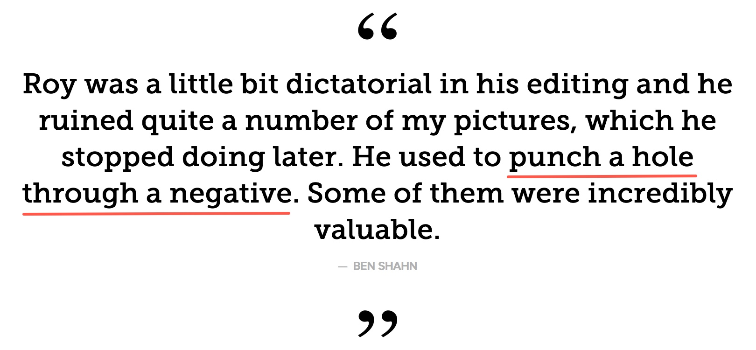

Slide 6
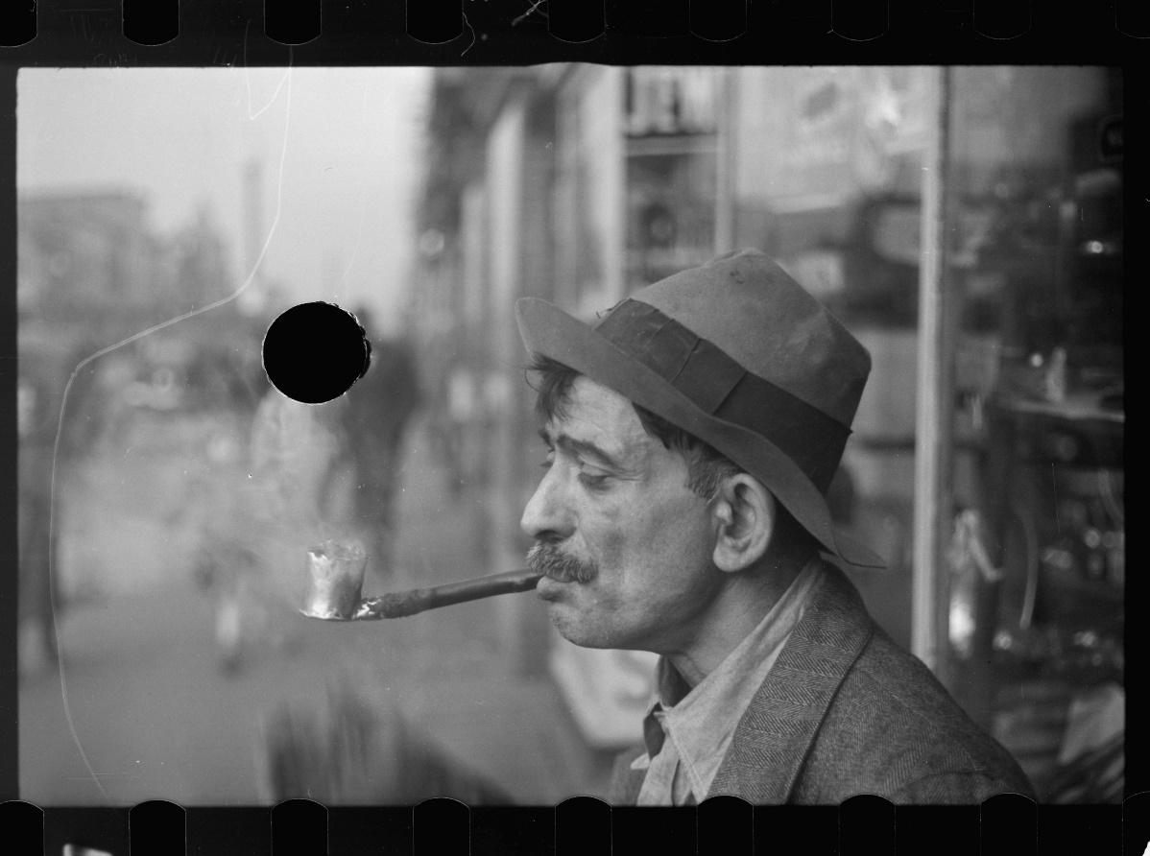
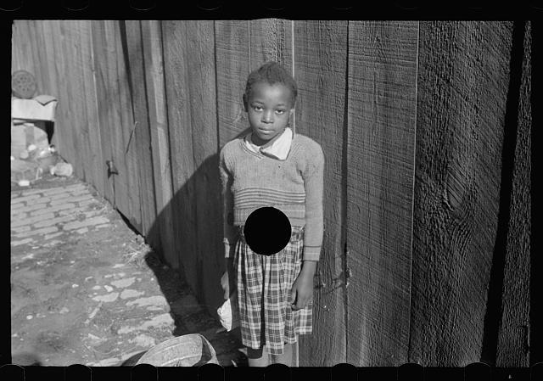
Roy Stryker Head of Information Division of the U.S. Farm Security Administration 1935-1941

Slide 7
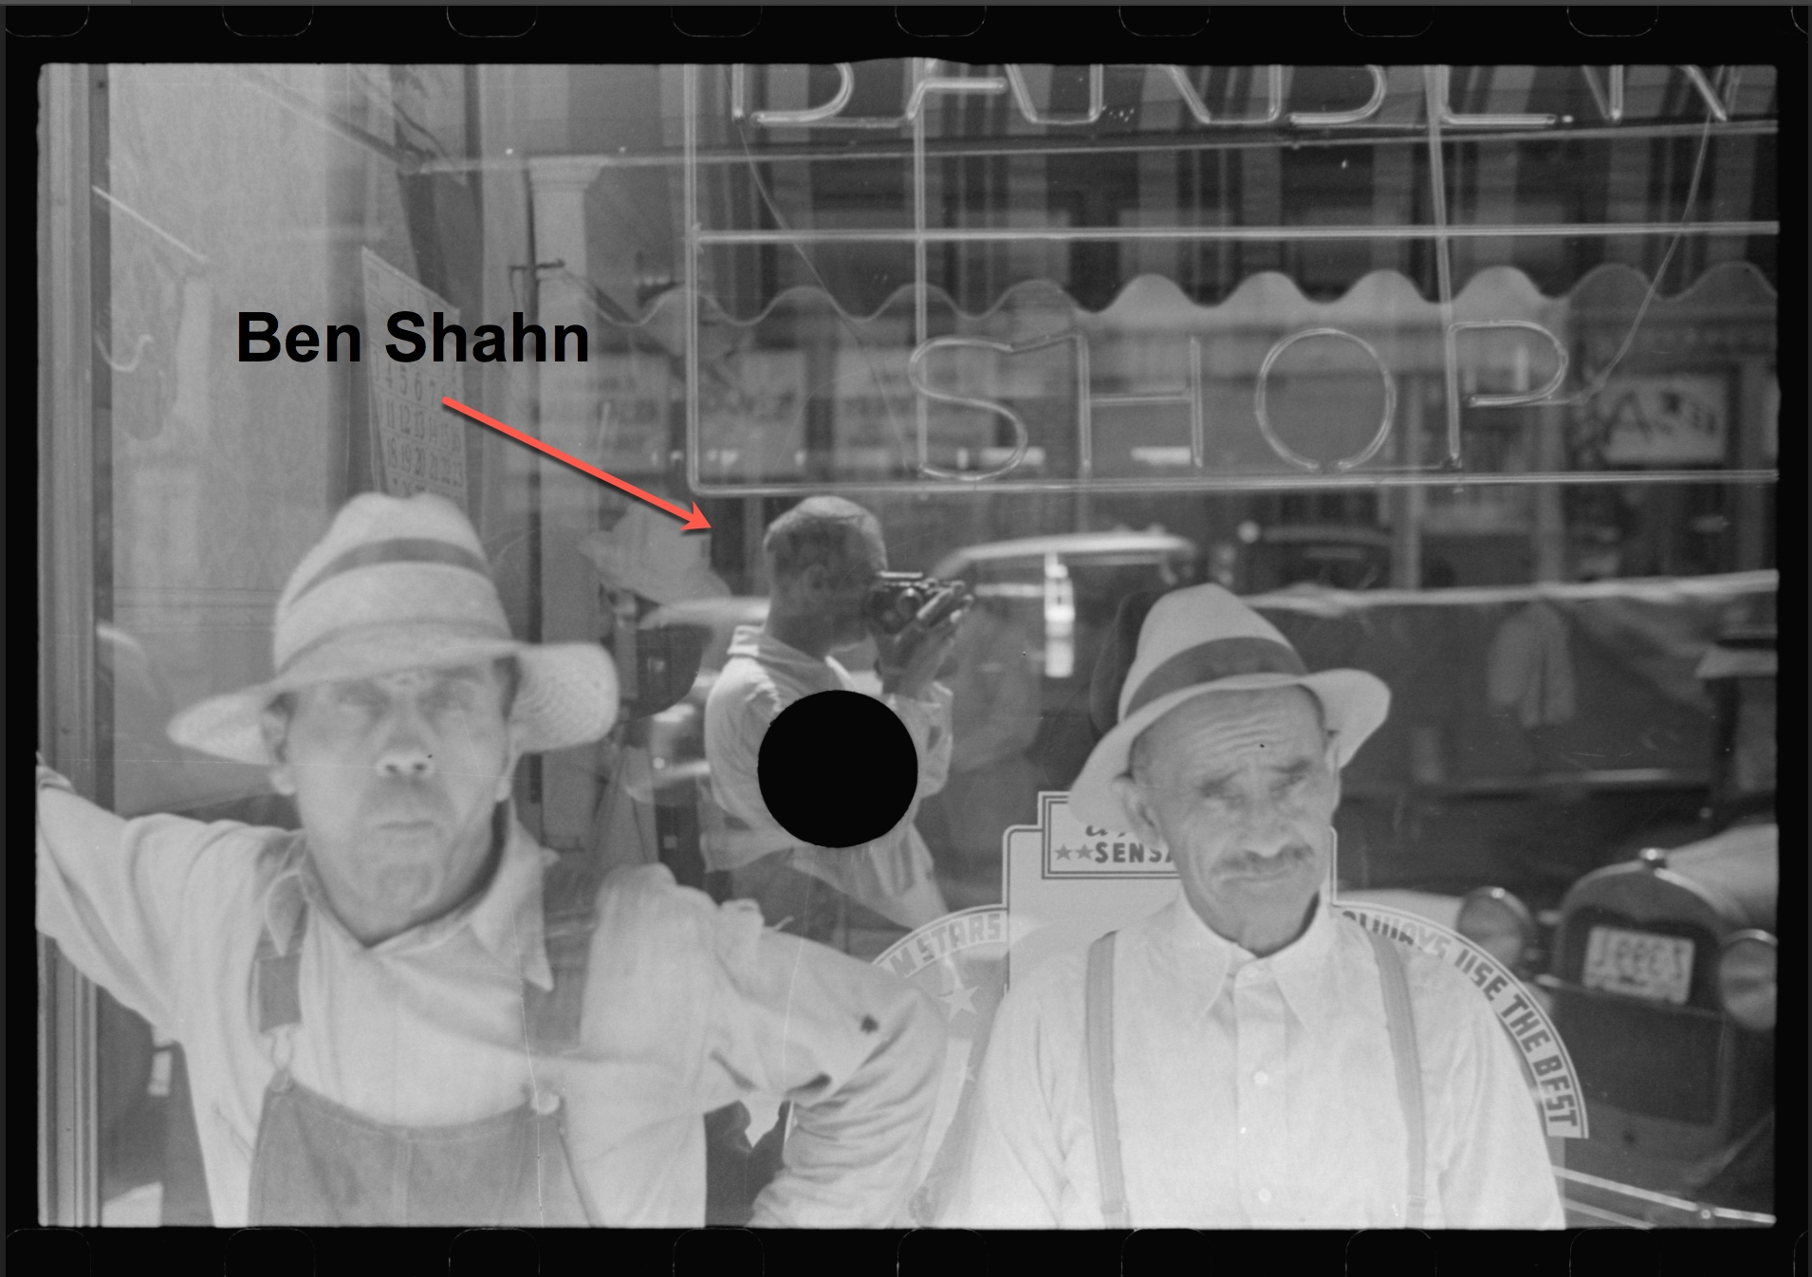

Slide 8
Questions...
With today’s advanced editing tools it is interesting to ask if these black holes might be revisited and perhaps algorithmically filled in just a few mouse clicks?
And if such a workflow was consistently successful, could it be automated across a large quantity of hole-punched images?

Slide 9
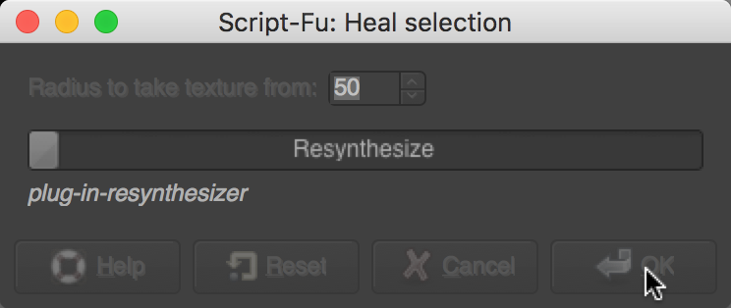
VS
First Introduced in 2010
First Introduced in 2005

Slide 14
Push and Pull: Evolving Technologies in Relation to Image Data
Today’s users have advancing visualization and interpretative tools at their disposal and with them the ability to ask new questions of our data.
Makes it difficult to anticipate use cases of our collective image data if we don’t have some acquaintance with these new methods.
The traditional aimpoints of digitization for “content replication” are evolving along with new capture technologies and techniques.

Slide 15
For More Details On This Study’s...
Research origins of each tool’s original development.
Experiments in the tools’ potential automated use.
The greater context of the resulting “filled” images.
The evolving nature of open image data and potential future use.

Slide 16
See the July ‘17 Issue of...
http://journal.code4lib.org/articles/12542

Slide 17
Thanks to…
Roy Stryker’s foresight in archiving his FSA photographers’ work with the Library of Congress.
The Library of Congress’ work in digitizing and describing this work over time.
The resulting open data!
Being able to recognize Ben Shahn at work…

Slide 18
A Final Value Narrative…

Slide 19
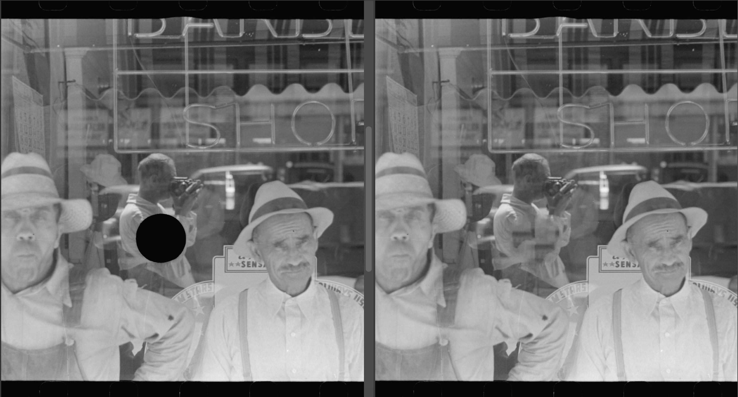

Slide 20
Thanks… Cultural Heritage Imaging Professionals Conference Stanford University July 10-12, 2017

