Slide 1
Optimized Still Image Batch Processing of Special Collections Bound Monographs and Manuscripts Using DNG, JPEG 2000, and Embedded XMP Metadata
IS&T Archiving 2012
June 15, 2012
National Museum of Denmark
Copenhagen, DK
Michael J. Bennett
University of Connecticut Libraries, Storrs, CT, USA

Slide 2
A Few Working Assumptions
Reformatting initiatives are becoming more broadly operational, larger scale, and systemic.
Notes:
Assume that we want to digitize everything in Special Collections & Archives and plan workflows and decisions accordingly.

Slide 3
A Few Working Assumptions
Simultaneously, as the software and formats that surround still imaging evolve, a greater need for more robust and flexible digital objects is becoming apparent to meet novel repurposing needs.

Slide 4
A Few Working Assumptions
In turn, decisions with regard to the scalable use of raw still image file archiving and processing, and data compression in general are important to consider when both quantity and quality are concurrent goals in today’s reformatting ecosystem.

Slide 5
Tradition States That…
Raw files are hard to work with.
Raw files are hard to batch edit, and they make it hard to create and preserve export rendition settings.
Storing both a raw and a raster version of a given image incurs higher storage costs than a single uncompressed 16 bit TIF.

Slide 6
In Fact, Today…
Raw files are becoming easier to work with.
Raw files can be more quickly batch edited than raster formats, and can create and preserve multiple export rendition settings in a single raw file.
Through compression, storing both a raw and a raster version of a given image can incur lower storage costs than a single uncompressed 16 bit TIF.

Slide 7
What Has Made This Possible?
Advances in image file formats
Advances in raw image editing tools
Creative repurposing of existing raster image editing tools

Slide 8
Things like this…

Slide 9
Bound Monograph Processing
Proprietary Canon .CR2 camera raw files are first converted into a folder of DNG safety masters
These are then segregated into left and right page Adobe Lightroom 3 Collections by either verso or recto page origin
Lossless rotatation and cropping of DNGs through synchronized Lightroom parametric edits that get written directly to the DNG file’s embedded metadata…

Slide 10
All “right” pages are selected and rotated

Slide 11
A crop box is drawn around one of the pages

Slide 12
Project-specific editing Preset is then applied to single page

Slide 13
Page’s cropping and editing adjustments synchronized out to the rest
of the LR Collection’s pages

Slide 15
Done

Slide 18
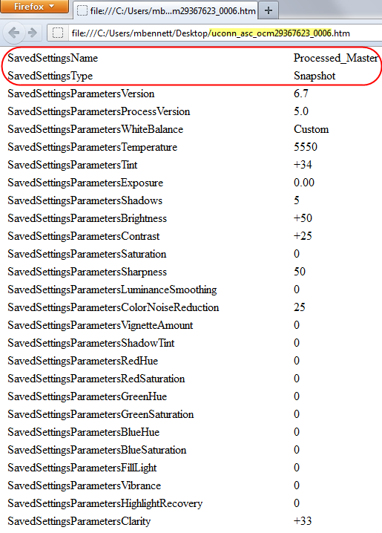
Snippet of ExifTool .htm dump from uconn_asc_ocm29367623_0006.dng Safety Master file with labeled “Processed_Master” snapshot and parametric adjustment settings.

Slide 19
A Few Words About “Snapshots”
Through the application of Snapshots, which can embed editing instruction sets into DNG files themselves, various DNG edited “states” can be easily called up in Lightroom (or Adobe Camera Raw).
From multiple selected DNGs, Snapshot-controlled “states” can then be quickly batch exported on demand as converted raster formats for various purposes (e.g. “Processed for Text Enhancement,” “Processed for Print Reproduction,” “Scene Referred State,” “Zeroed or Linear Latent State,” etc.).

Slide 20
A Few Words About “Snapshots”
Snapshots are a flexible feature of the documented DNG specification that can be generally utilized by raw editing software other than Adobe.
Snapshot settings will most-likely be interpreted differently across a variety of raw editing software and versions other than the software that originally created the snapshot.
Embedded DNG previews and/or separately-rendered formats can, however, serve as stable reference images for particular renderings across time.

Slide 21
Scanner DNGs
DNGs can also be created directly from scanners through the use of VueScan software.
In this way a measure of parametric editing workflow and image format continuity can be coordinated among a conversion lab’s given range of capture devices.
As a result, aspects of batch parametric processing need not be completely re-written from scratch for each equipment type but can be repurposed and shared among a broader spectrum of cameras and scanners.

Slide 22
Scanner DNGs
It bears noting that as opposed to color filter array (CFA) sensor devices like the majority of today’s digital cameras, common flatbed scanners employ a trilinear array of RGB-filtered CCD sensor elements.
In turn, unlike CFA-based camera DNGs that contain mosaic sensor data, native scanner DNGs are linear encoded RGB files at inception.
Such linear DNGs, however, can still enjoy many of the same lossless parametric editing efficiencies as camera-based DNGs.

Slide 23
Putting It All Together w Lossless JPEG 2000

Slide 24
…and Embedded XMP Process Metadata

Slide 25
Leveraging Embedded XMP Across Image Format Types
File-embedded XMP and its support for IPTC Core opens up new opportunities to create more robust still image files.
Such files can contain not only device-generated Exif information and parametric editing instruction tags (including Snapshots), but can also contain IPTC Core elements that can be edited either individually or in batches.

Slide 26
Leveraging Embedded XMP: Advantages
Individual still image files can be less dependent upon traditional external catalogs for their descriptions and can in essence be self-describing assets with sufficient descriptive information.
This is of particular interest as images are exported and repurposed beyond the institutional gates of their creation and become de-coupled from their original hosted settings.

Slide 27
Leveraging Embedded XMP: Advantages (con.)
Once embedded in all files, both descriptive and technical process metadata greatly assist in original digital asset management (DAM) system imports and/or future DAM platform migrations.
Similarly, XMP’s serialized XML structure incorporates well when repurposed and leveraged through OAIS digital preservation technology stacks like Archivematica and repository frameworks such as Fedora.

Slide 28
Schematic View of UConn Monograph/Manuscript Folder Conversion Workflow

Slide 29
Contact
Michael J. Bennett
Digital Projects Librarian
University of Connecticut Libraries, Storrs, CT, USA
michael.bennett@lib.uconn.edu
Presentation: http://digitalcommons.uconn.edu/libr_pres/39
Full Conference Paper: http://digitalcommons.uconn.edu/libr_pubs/43/

