Slide 1
Variations 6.0 Pilot
UConn
2010 - 2011
Anna E. Kijas
Music & Dramatic Arts Librarian
University of Connecticut
April 14, 2011
NERCOMP Evaluation: bit.ly/nercomp_media

Slide 2
Overview
Background on Digital Audio @ UConn
Why Variations 6.0?
Tech Specs
Timelines & Examples
Staff Time
Workflow
Staff
Music & Dramatic Arts Librarian
Access Services Manager
MDAL student workers
Library ITS staff

Slide 3
Background on Digital Audio
@ UConn
2004 – present
  Music & Dramatic Arts Library uses a homegrown system for their Digital Audio Reserves (D.A.R.)
  D.A.R. provides streamed audio access via HuskyCT to music owned by the University Libraries
  Access is limited to instructor and students enrolled in participating courses
  Access ends once course/semester ends

Slide 4
Background on Digital Audio
@ UConn
D.A.R. is only used for course reserves
  Allows access to single tracks uploaded and digitized by the MDAL staff
  Does not provide access to entire albums nor to the OPAC record or album information
  Does not provide music-related tools

Slide 5
Why Variations 6.0?
Variations 6.0 is Open Source software
It is a digital music library and learning system
  Allows users to listen to entire albums
  Allows users to create playlists, drills, and timelines for analysis
Ease of use (staff and patrons)
Quick turn-around time
ITS – discontinue use of Helix server

Slide 6
Tech Specs
Trial Variations server:
  RedHat EL 5 virtual machine hosted on VmWare Server on a Dell PowerEdge 2900 server
Virtual Machine:
  2 CPUs and 500 MB RAM

Slide 7
Original Timeline
May – June 2010
  Discuss and agree on collaboration between MDAL and Library ITS department
July – August 2010
  Implement and test of Variations client
  Present Variations to Faculty
September 2010 – January 2011
  Install on public PCs in MDAL
  Create Variations client download (for users)
  Continue testing client
  Train Library Staff and Students
  Digitize audio for course reserves 2011
  Implement for Spring 2011

Slide 8
Modified Timeline
February – April 2011
  Revise original D.A.R. policy
  Submit policy to Attorney General’s Office for approval
May 2011
  Install on public PCs in MDAL
June– August 2011
    Move VM server for Variations into our production infrastructure, which is a highly redundant ESX platform and SAN (ITS)
    Train Library Staff and Students
    Demonstrate Variations to Faculty and TA’s
    Digitize audio for Fall course reserves
September –December 2011
    Implement Variations for Fall course reserves

Slide 9
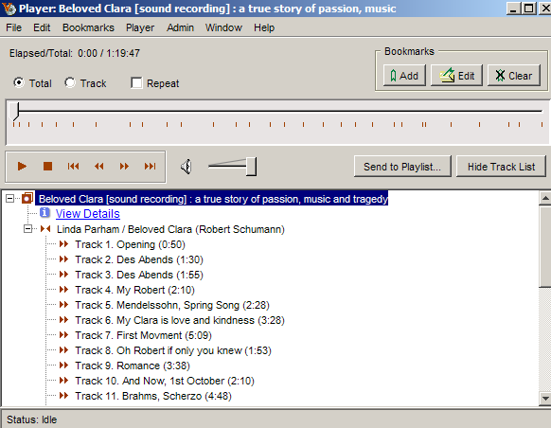
Audio Player

Slide 10
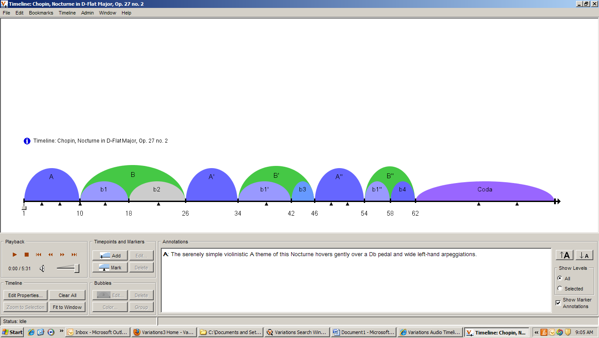
Audio Timeliner

Slide 11
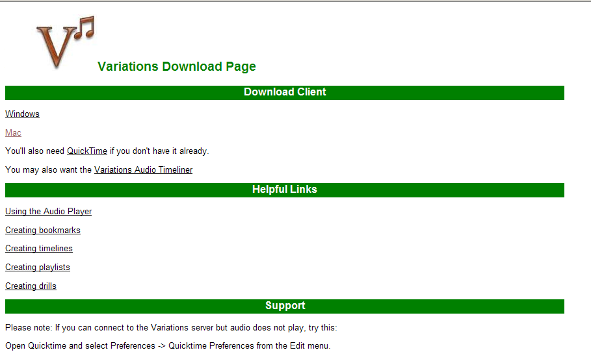
Variations Download Page
http://variations.lib.uconn.edu/

Slide 12
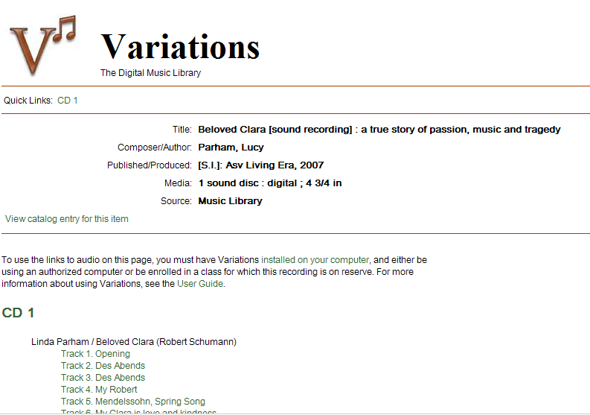
Variations Access Page

Slide 13
D.A.R. Policy
2004 Policy stated:
The Libraries will reproduce only the works needed, rather than entire
audio discs, unless the disc itself is one large work. Library staff will
not reproduce or share files for any other purpose.
Revised Policy states:
In compliance with copyright, the Libraries may provide
electronic transmissions of the following audio materials:
Performances (partial or entire) of all non-dramatic musical works. Such works would include all music other than operas, musicals, and ballets.
Reasonable and limited portions of any dramatic musical works, (e.g. operas, musicals, and ballets).
Other materials with appropriate permissions of the copyright holder.

Slide 14
Time & Effort
(ITS and MDAL)
May 2010 - present
Read and understand the documentation: 2 hrs
Install the software: 2 days
Configure, monitor, tweak the client: 1 hr
Create download package for Variations: 30 min.
Revise D.A.R. Policy: 2 hrs
Submit D.A.R. Policy to AG’s office: and wait

Slide 15
MDAL Staff Time
Digitization process
  Burn and encode audio file: 7 minutes
  Digitize in Variations module: 3 minutes*
  Link in HuskyCT: 2 minutes
  Total time per CD: 12 minutes
  *Times are approximated based on individual staff experience.

Slide 16
Cost??
Staff time
Equipment
Open Source Software
Maintenance

Slide 17
Variations Workflow
In-take of Digital Audio Reserves (D.A.R.)
D.A.R. request is placed and approved
Staff is added as section designer in HuskyCT (by Faculty)
Digitization
Requested CDs are pulled from shelves
Use Foobar 2000 to burn CD(s)
Use Variations MP4 Encoder to encode WAV files
Import into and publish audio files in Variations
Access in HuskyCT
Link audio files in HuskyCT
Test tracks

Slide 18
Please visit: bit.ly/nercomp_media
to complete evaluation for NERCOMP
Thank you!

