Slide 1
Illustrating the Principles of Basic DAM through Adobe Lightroom
Michael J. Bennett, Digital Projects Librarian
University of Connecticut
February 4th, 2010

Slide 2
Background
DAMs do three major things with digital assets:
Import
Search
Export

Slide 3
Background
What goes into the DAM? - Previews (thumbnails, etc.) - Metadata (descriptive, administrative, technical) - each of the above are initially derived from the original archival digital objects What doesn’t go into the DAM db? - the actual archival objects themselves Ramifications? - DAM indexes metadata and acts as a catalog for visual browsing and advanced searching of all digital assets. After preview and metadata import, a DAM can go “offline” from the original archival files until an export step is needed.

Slide 4
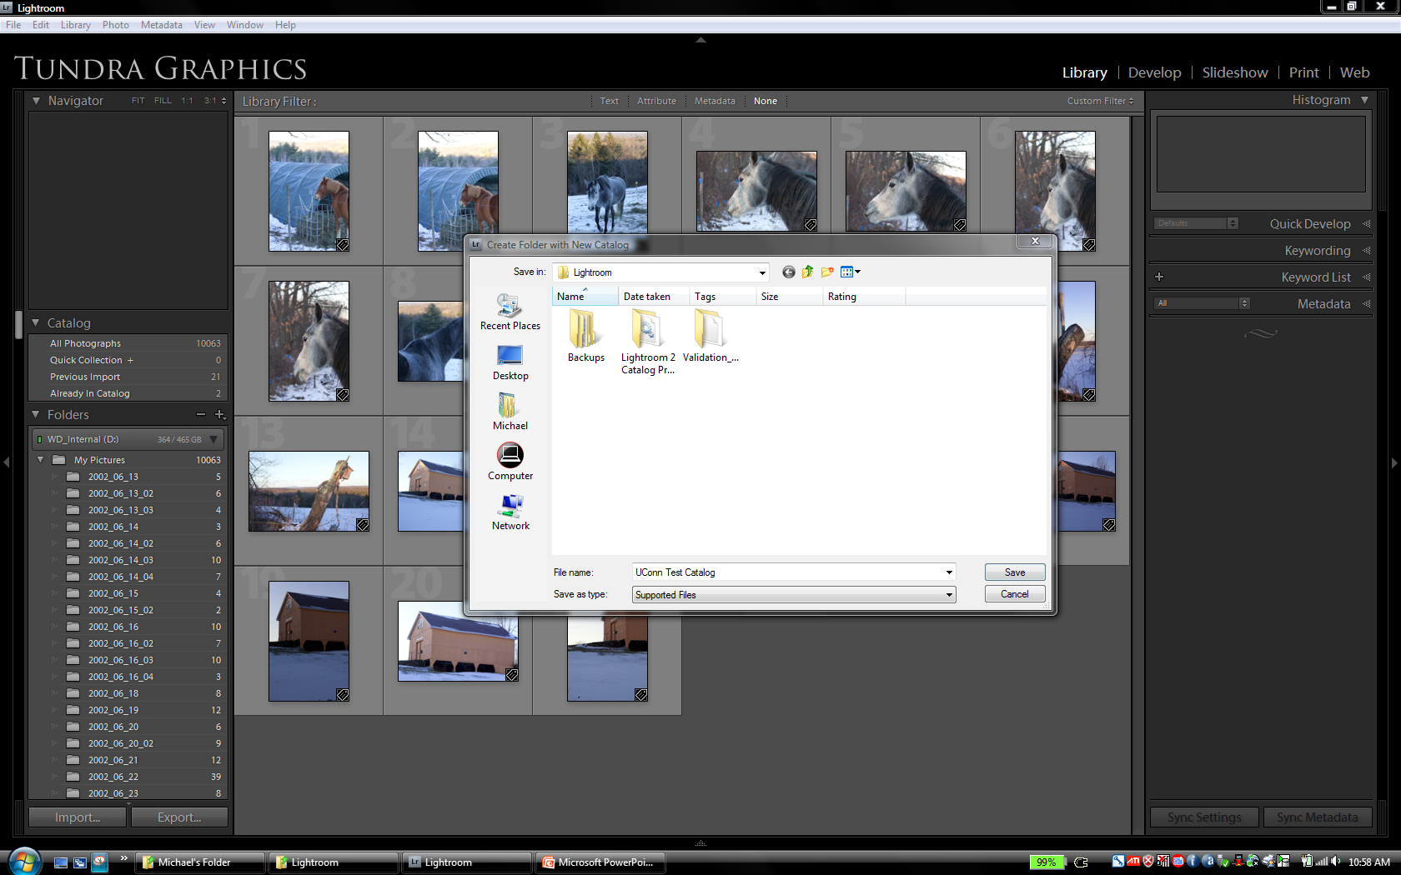
I. Lightroom Import
C:\Users\Michael\Pictures\Lightroom\UConn Test Catalog will be the destination for both preview images and metadata. Previews live in a catalog-specific .lrdata file while metadata lives in a .lrcat file. Both are based upon SQLite.

Slide 5
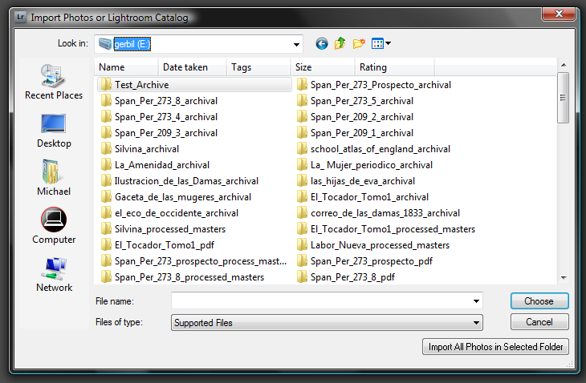
I. Lightroom Import
Here, we’re targeting a directory of archival files (“Test_Archive”) off of an external HD E:

Slide 6
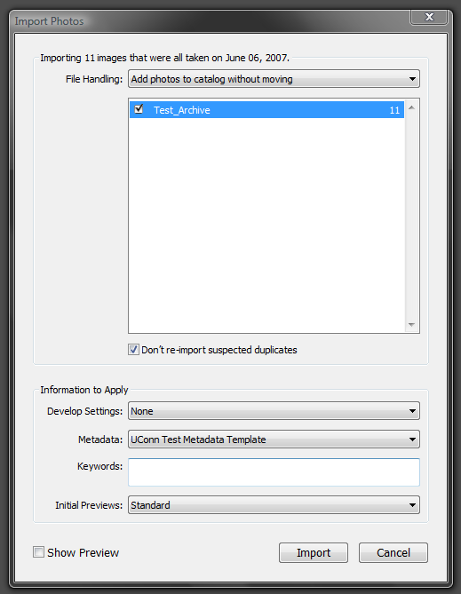
I. Lightroom Import
By adding photos to catalog w/o moving, we are leaving the archivals alone. Also, note a project-based metadata template that was previously created in Lightroom is being applied to all of the imported records.

Slide 7
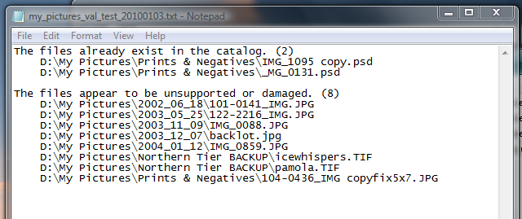
I. Lightroom Import
Archival files that are corrupted do, however, produce Lightroom error reports during import. (Note: screenshot taken from separate import routine, not E:\Test_Archive)

Slide 8
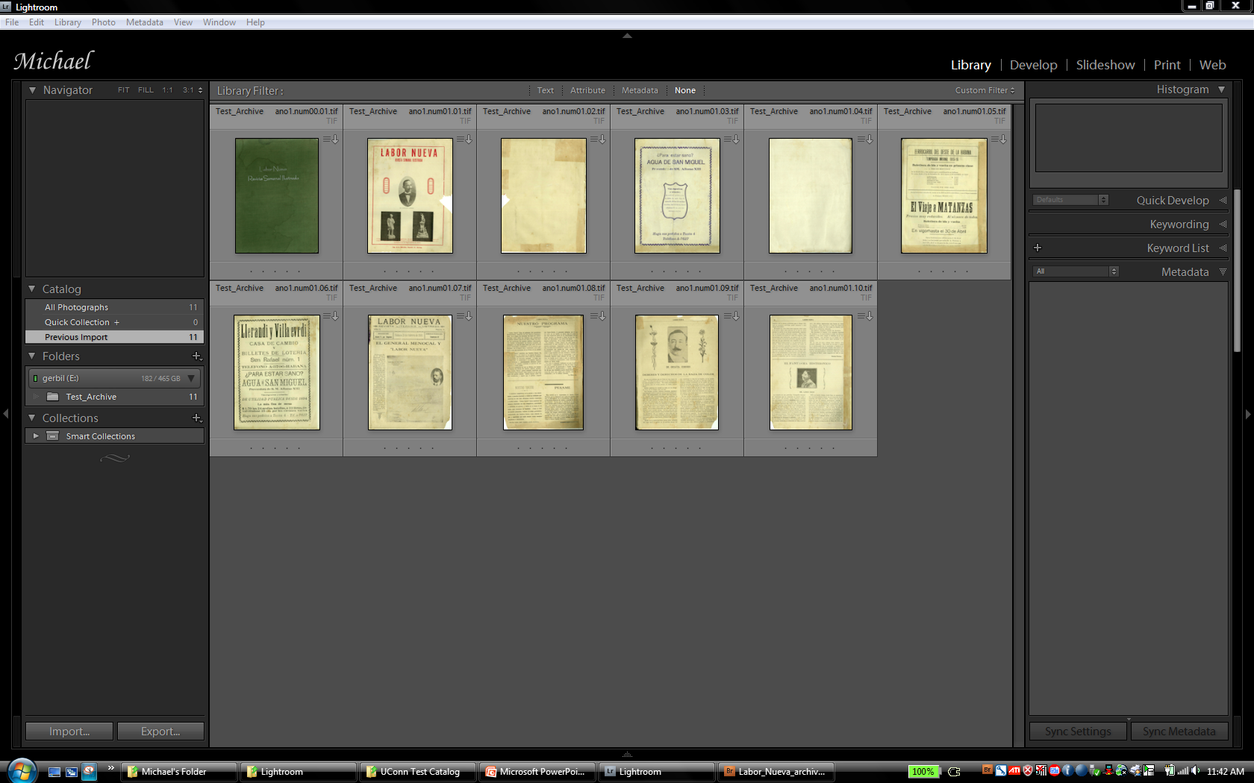
I. Lightroom Import
View after import.

Slide 9
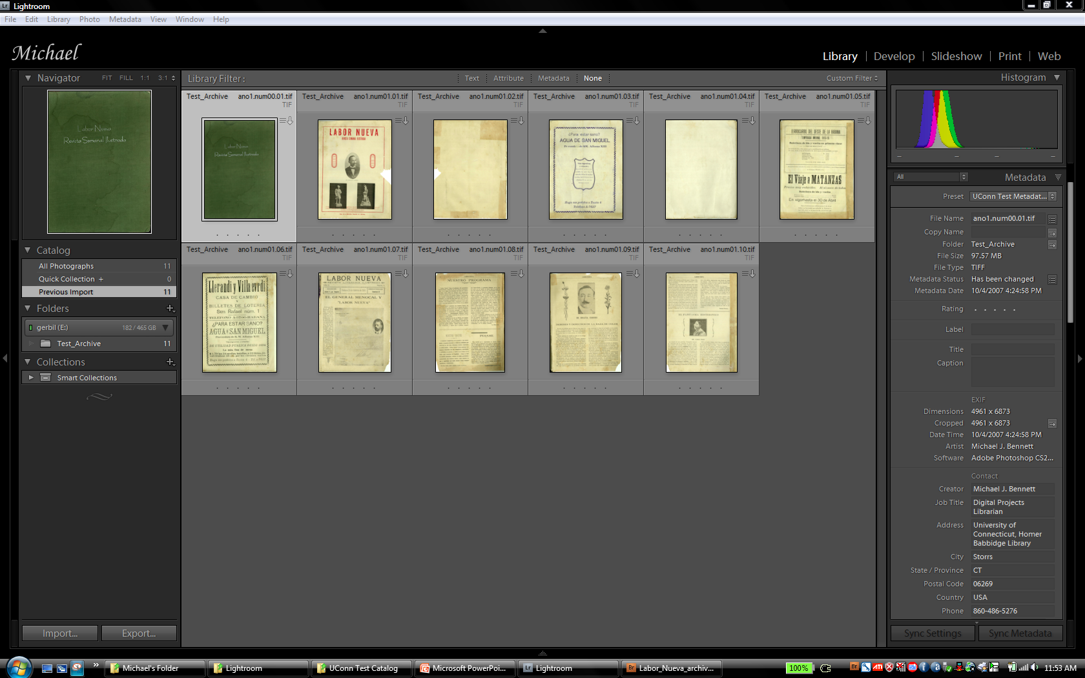
I. Lightroom Import
A single click on an item reveals the Metadata panel along the right side…

Slide 10
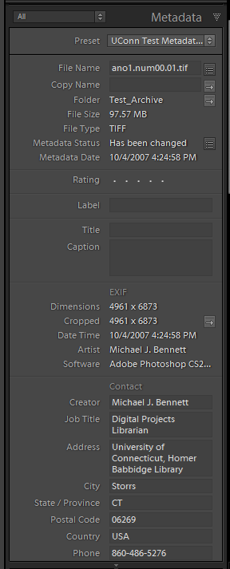
I. Lightroom Import
Here’s a look at the first section of metadata in the panel. This is a combination of Exif technical metadata supplied automatically from the capture device, and administrative metadata provided by the project metadata template. Remember, the metadata from the template was added to the catalog for the object during import. Additional metadata can be added to individual objects through the Lightroom metadata panel. Metadata from one object can also be synched among a collection’s objects…

Slide 11
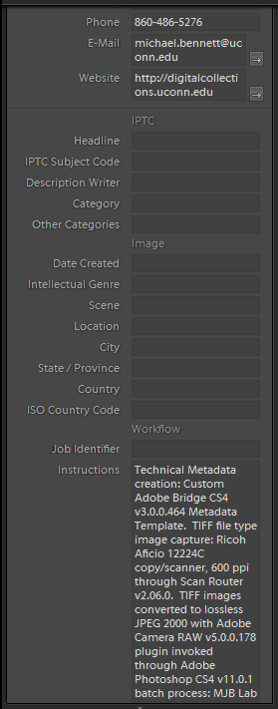
I. Lightroom Import
…scrolling down through the fields. Exif, IPTC, etc. are all gathered within the broader XMP metadata space. (Note: this image already had some technical metadata applied to it before import from Adobe Bridge that Lightroom, in turn, harvested into the catalog and appended its own metadata template data around).

Slide 12
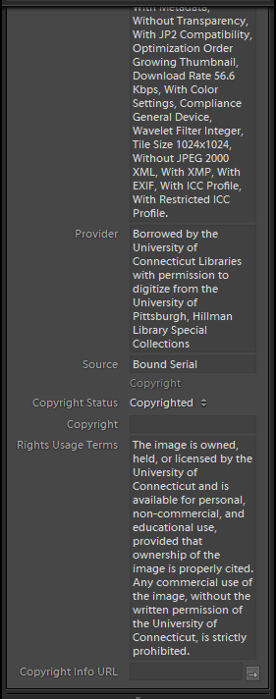
I. Lightroom Import
…more fields, more metadata. Other than Exif, all of the fields are editable within the panel.

Slide 13
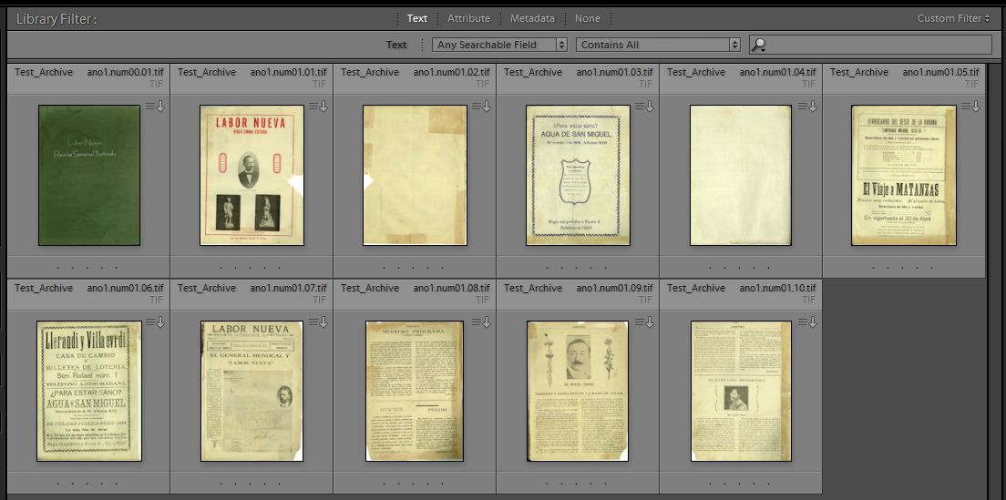
II. Lightroom Search
DAMs have the ability to take all of that metadata and leverage it for discovery across broad file types and physical locations. Here’s how Lightroom facilitates this.

Slide 14
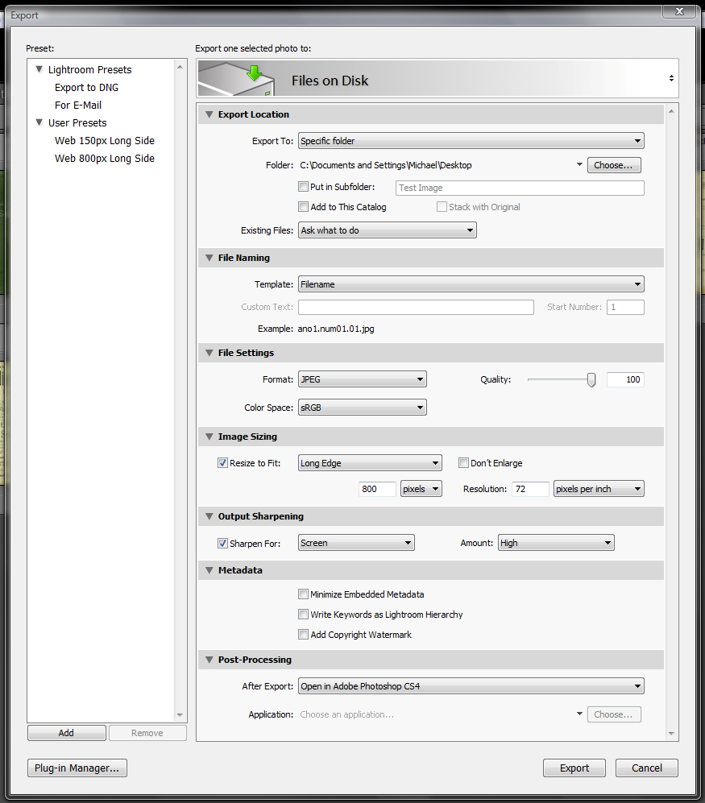
III. Lightroom Export
Compressed and optimized derivatives (output sharpened, etc.) can be made either individually or in batches through customized output or saved presets for web, print or other targeted reproduction spaces. A record of such fulfilled requests can then be written back to the individual object’s catalog metadata for tracking. Batches of exported items can be the result of custom searches across the catalog, etc. *Note: for the DAM to be able to generate such reproduction derivatives it must go “online” and have temporary read access to the original archival files.

Slide 15
IV. Why not just use Lightroom, then???
Lightroom only supports raw/DNG, TIFF, and JPEG formats. Not broad enough to handle JPEG 2000 or other electronic record types (e.g. MS Office files, etc.)
Lightroom has no hard image limit, but it has reported to be slow to non-responsive somewhere between 20,000 and 60,000 images per virtual catalog.
Lightroom isn’t technically OAIS-based. But it could, as could other DAM offerings, possibly work in tandem with an OAIS-compliant archival file system since a DAM needn’t write back to the archival files or be a part of original OAIS ingestion.
Enterprise-level DAM offerings should overcome some of these pitfalls but may not offer comparable built in image/file optimization tools as Lightroom, however.

Slide 16
V. What else is out there???
Extensis Portfolio
Microsoft Expression Studio
Media Beacon
Canto Cumulus
Artesia
Ex Libris Rosetta

Slide 17
Readings
Albrecht, Kathe Hicks. “Taming the many-headed DAM.” Pasadena, CA, 2006. http://www.mcn.edu/conference/mcn2006/SessionPapers/MCN2006_DAM_Albrecht.pdf.
Blum, Stanley D. “Perspectives on building a digital asset management system views from the California Academy of Sciences, a Natural History Museum.” Pasadena, CA, 2006. http://www.mcn.edu/conference/mcn2006/SessionPapers/MCN2006_DAM_Blum.pdf.
Frey, Franziska S. and Jeffrey Warda. The AIC guide to digital photography and conservation documentation. 1st ed. Washington [D.C.]: American Institute for Conservation of Historic and Artistic Works, ©2008.
Krogh, Peter. The DAM book : digital asset management for photographers. 2nd ed. Beijing ; Cambridge [Mass.] : O'Reilly, ©2009.
Levy, Trudy, and Maureen Burns. “Trying to tame the many-headed DAM.” Pasadena, CA, 2006. http://www.mcn.edu/conference/mcn2006/SessionPapers/MCN2006_DAM_Levy_et_al.pdf.
McCord, Alan. “Overview of Digital Asset Management Systems,” September 6, 2002. http://net.educause.edu/ir/library/pdf/DEC0203.pdf.

Slide 18
The End

