Slide 1
Google Analytics & CONTENTdm: Harness Up Your Repository Metrics
Michael J. Bennett
Digital Projects Librarian & IR Coordinator
University of Connecticut
Eastern CONTENTdm Users Group Conference
Yale University
New Haven, CT
August 6th – 7th, 2009

Slide 2
I. Basic Installation

Slide 3
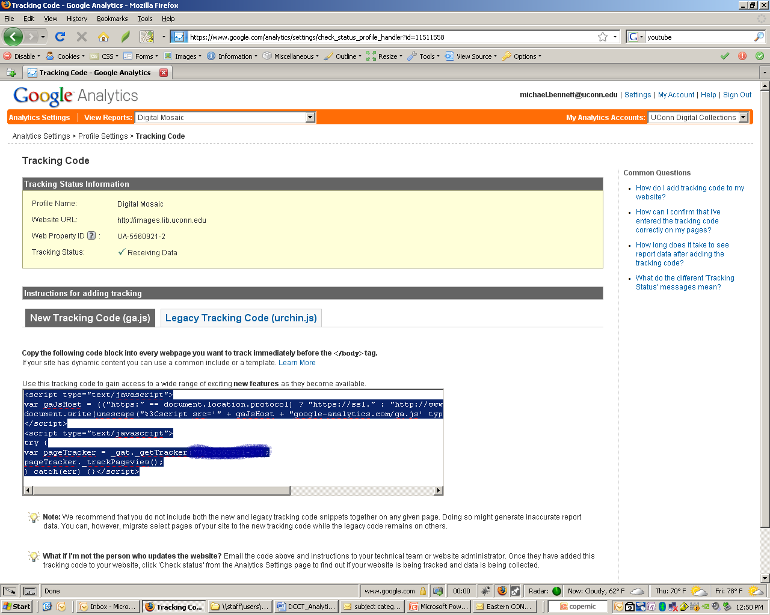
Step 1: Copy Analytics’ Tracking Code snippet from your Analytics Settings…

Slide 4
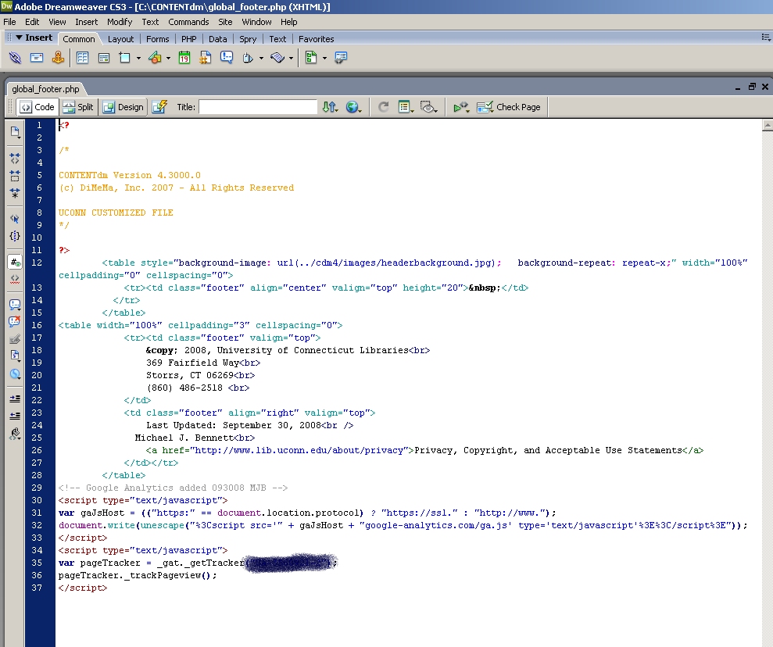
Step 2: … and paste snippet into the bottom of global_footer.php (usually found in /Content4/docs/cdm4/includes)

Slide 5
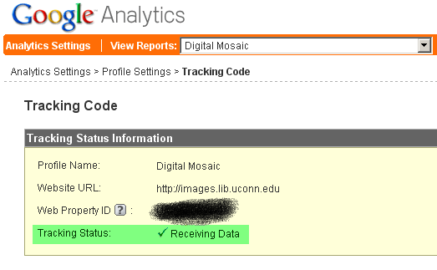
Step 3: Check back in on Tracking Status in 12-24 hours to verify that code snippet is allowing Google to compile web analytics.

Slide 6
II. Harness Answers (by starting with good questions)

Slide 7
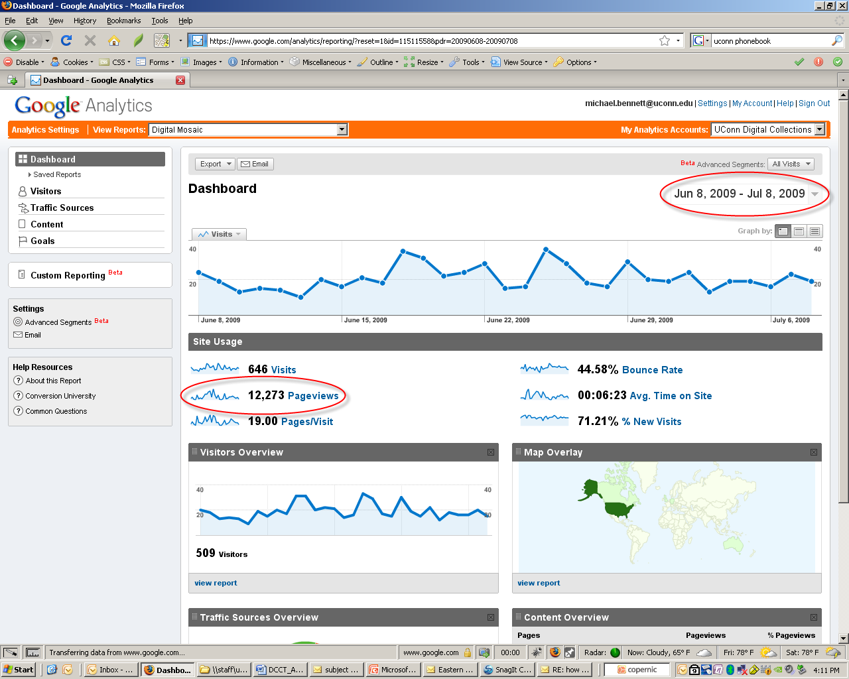
Q 1: How much total online traffic has there been going on at http://images.lib.uconn.edu/ (aka Digital Mosaic) in the past month?

Slide 8
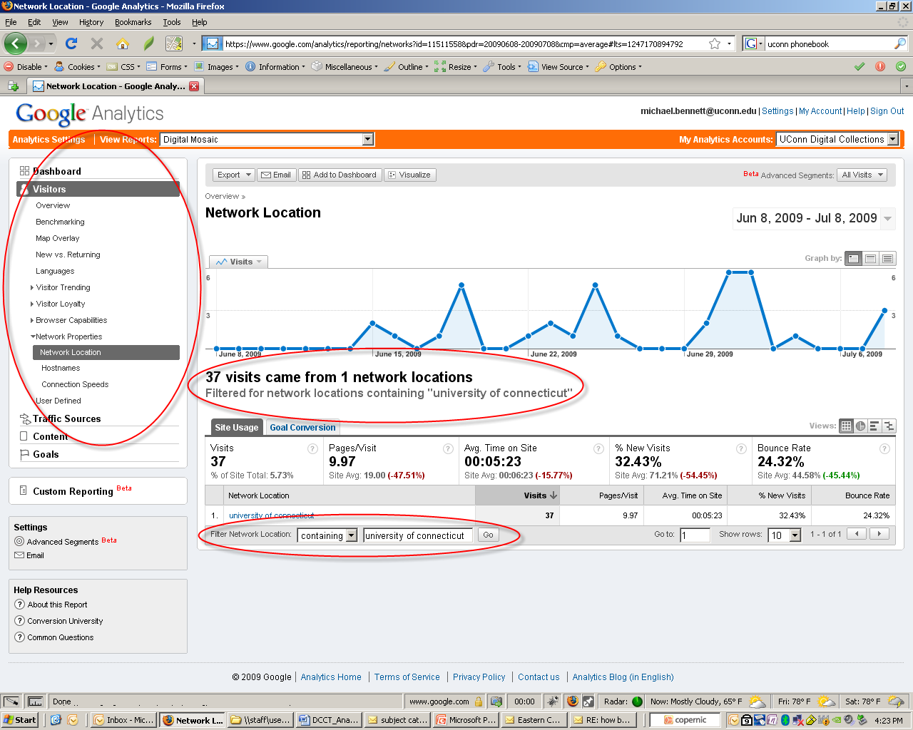
Q 2: How much total online traffic has there been going on at Digital Mosaic in the past month within the UConn network?
Notes:
When a visit is reported to GA, it includes the IP address. GA doesn’t report the IP address (Google considers this Personally Identifiable Information so their privacy policy prohibits it), but it does look up who the IP Address belongs to, http://www.lunametrics.com/blog/2008/12/15/network-location-google-analytics/ (retrieved 7.27.09). See also: ARIN WHOIS Database Search for IP address searches based upon Network Location, http://ws.arin.net/whois/

Slide 9
NOTE:
When a visit is reported to GA, it includes the IP address. However, GA doesn’t report the IP address (Google considers this Personally Identifiable Information so their privacy policy prohibits it), but it does look up who the IP Address belongs to, http://www.lunametrics.com/blog/2008/12/15/network-location-google-analytics/ (retrieved 7.27.09).
See also: ARIN WHOIS Database Search for IP address searches based upon Network Location, http://ws.arin.net/whois/

Slide 10
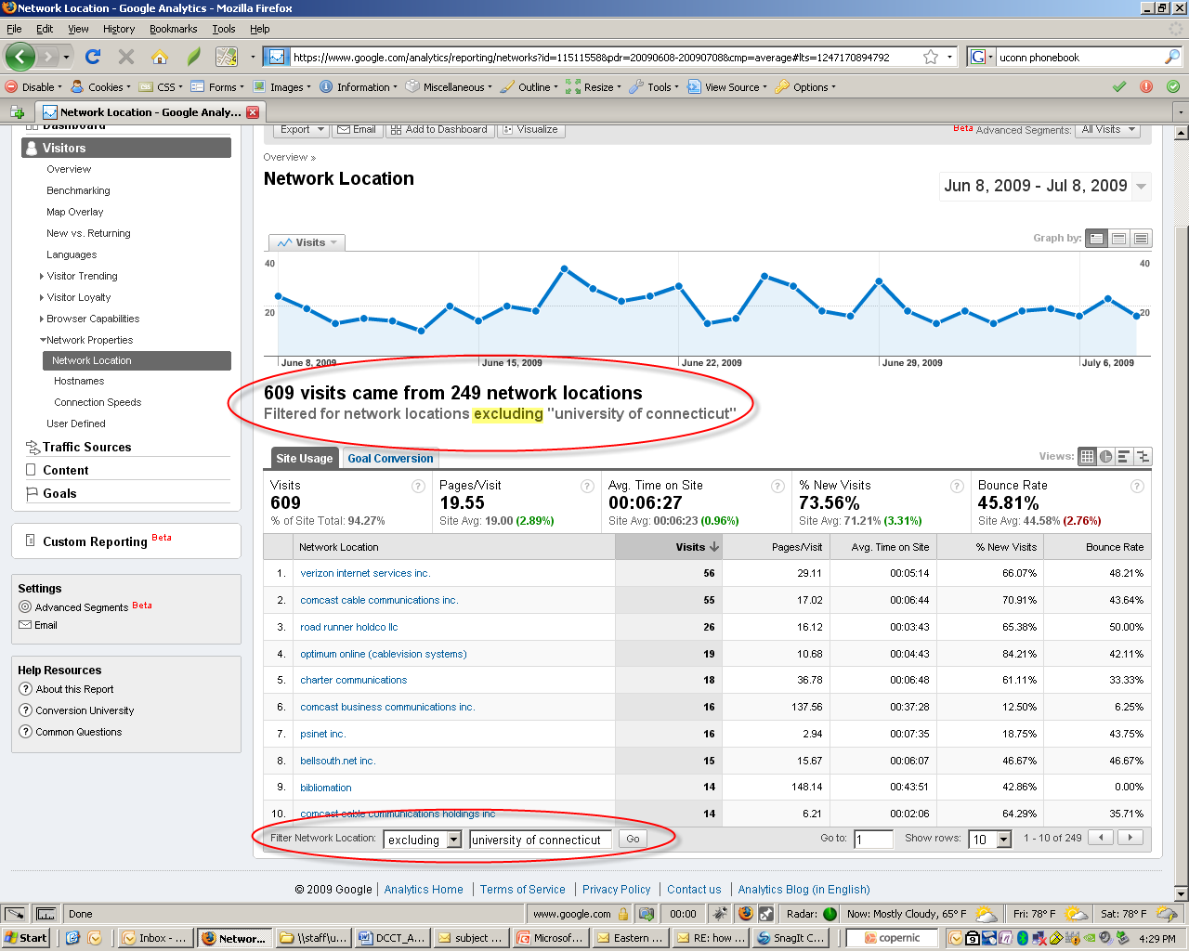
Q 3: How much total online traffic has there been going on at Digital Mosaic in the past month outside the UConn network?

Slide 11
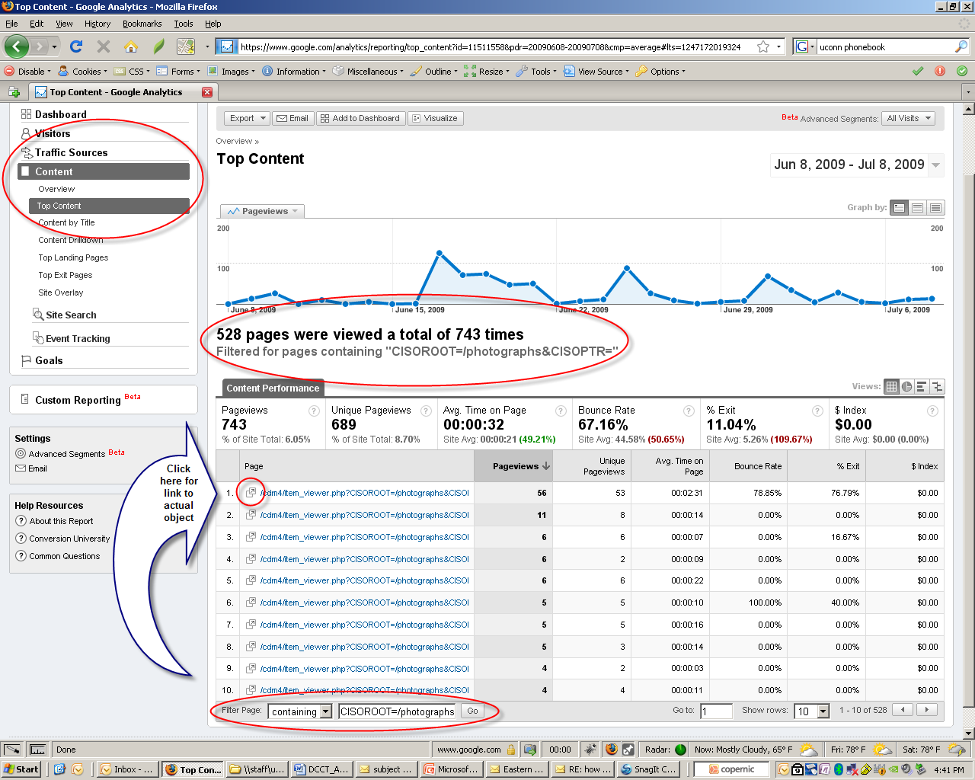
Q 4: How many total pageviews of individual digital objects have there been going on at the Photographs Collection from both inside and outside the UConn network in the past month?

Slide 12
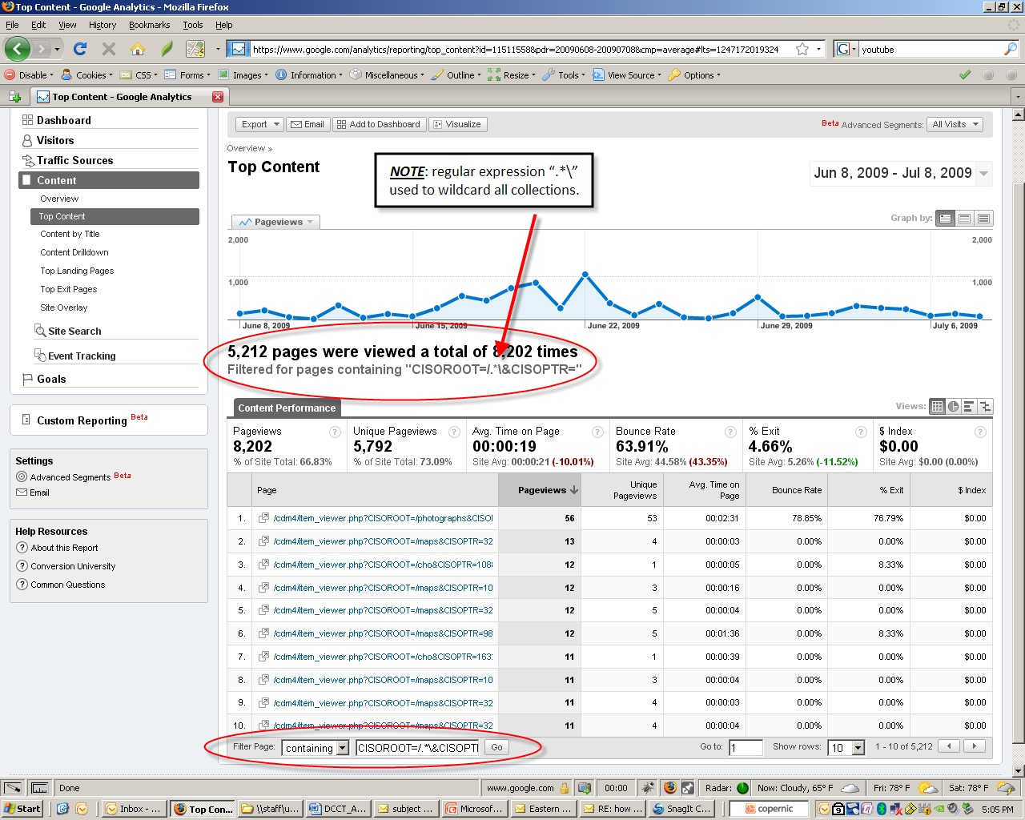
Q 5: How many total pageviews of individual digital objects have there been going on across all Collections from both inside and outside the UConn network in the past month?

Slide 13
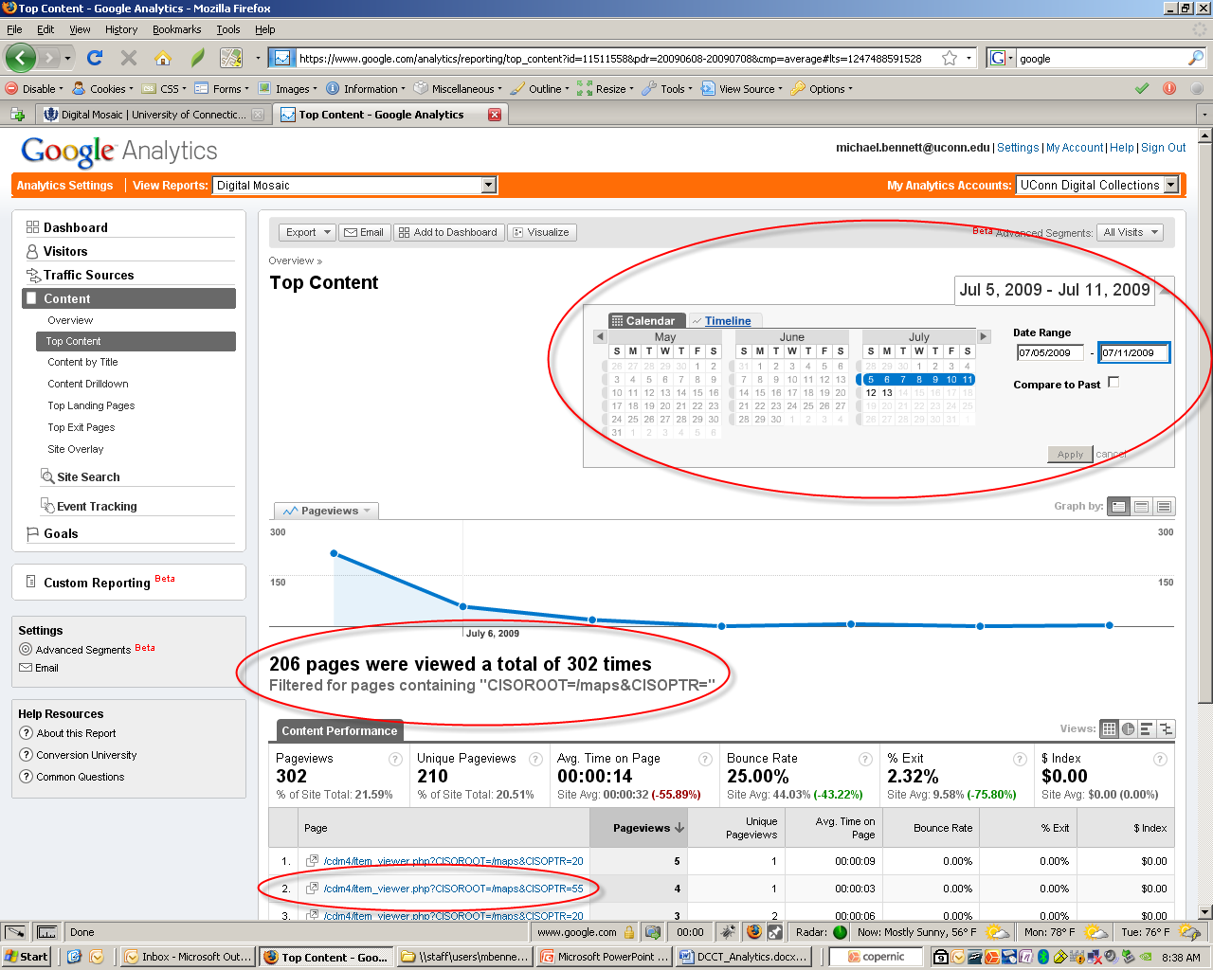
Q 6: What is the 2nd most popular digital object from the Maps Collection from last week?

Slide 14
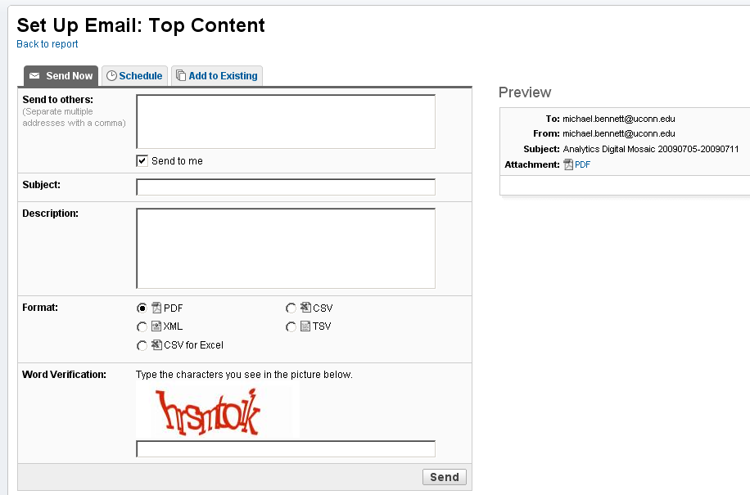
Q 7: What are my options to export this report?
Q 8: What are my options to email this report?

Slide 15
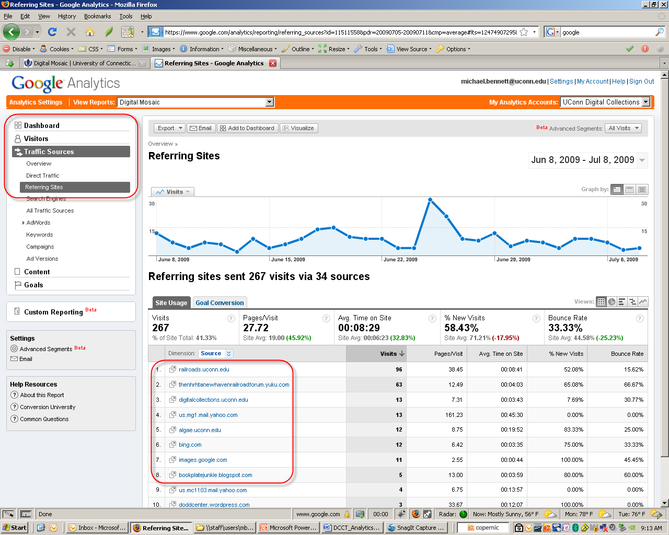
Q 9: What other sites have referrals to Digital Mosaic?

Slide 16
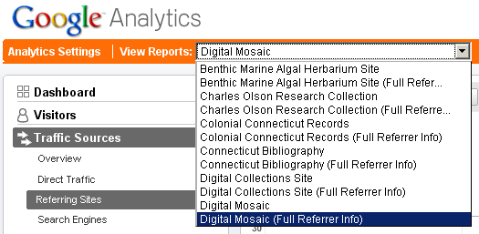
Q 10: What are some of the individual pages that these referrals are coming from? Step 1: Set up separate "Full Referrer Info” Profile.

Slide 17
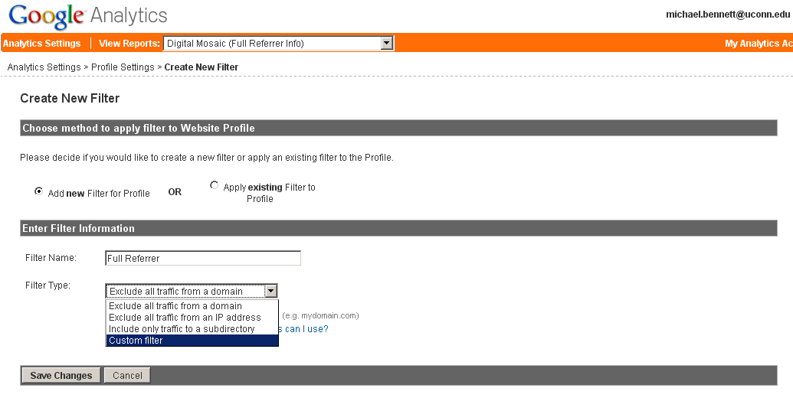
Q 10: What are some of the individual pages that these referrals are coming from? Step 2: Add Custom Filter to this profile.

Slide 18
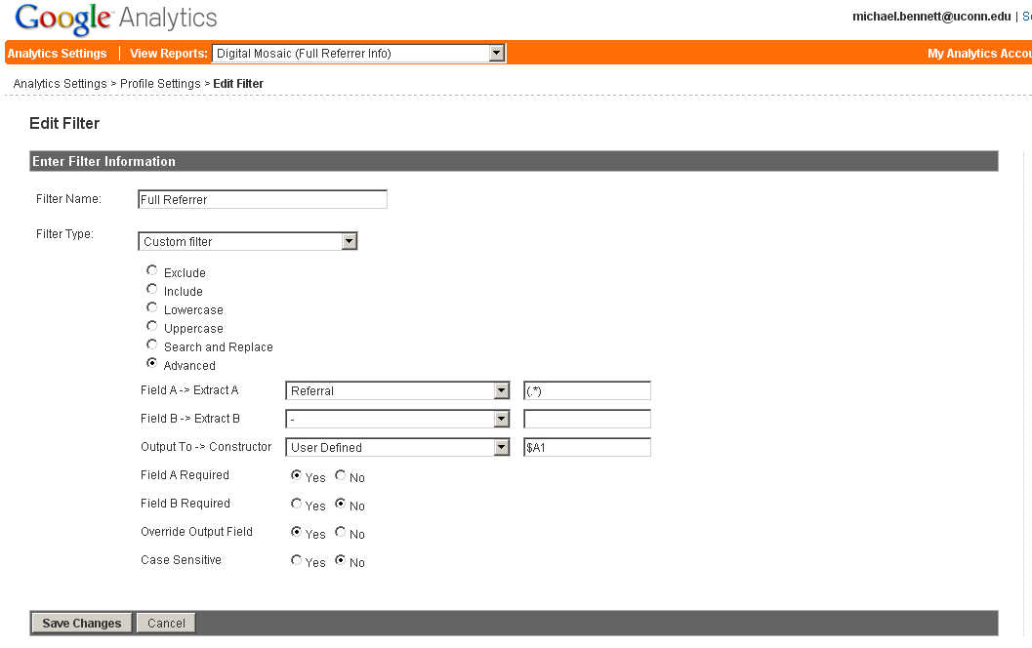
Q 10: What are some of the individual pages that these referrals are coming from? Step 3: Configure Advanced Filter called “Full Referrer” and apply it to profile (see: http://www.vdgraaf.info/filters-in-google-analytics.html for additional background on the origin of this filter).

Slide 19
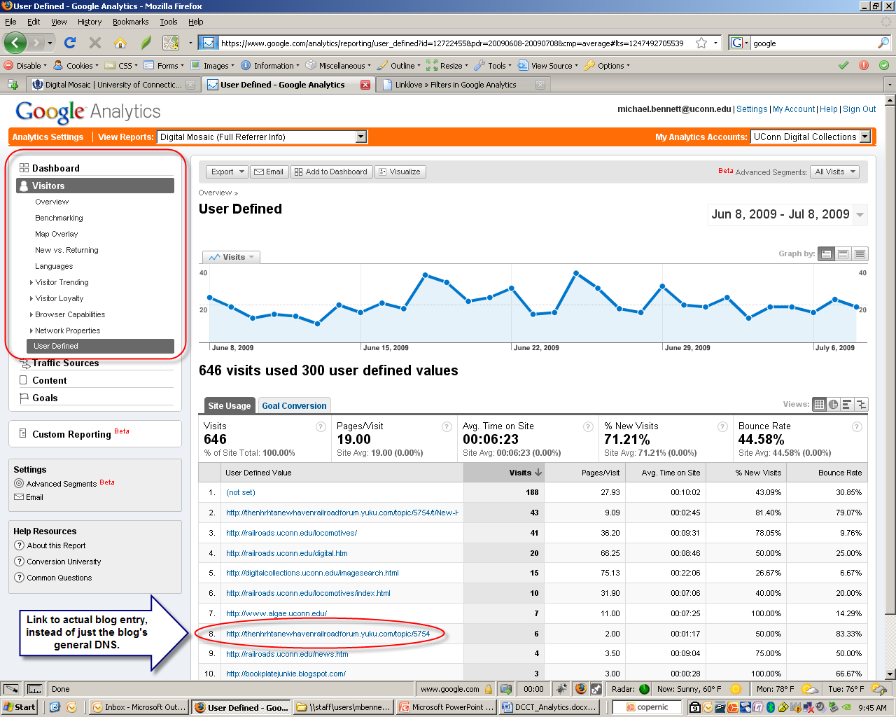
Q 11: What are some of the individual pages that these referrals are coming from? Step 4: View Report, Copy and paste URL into new browser tab.

Slide 20
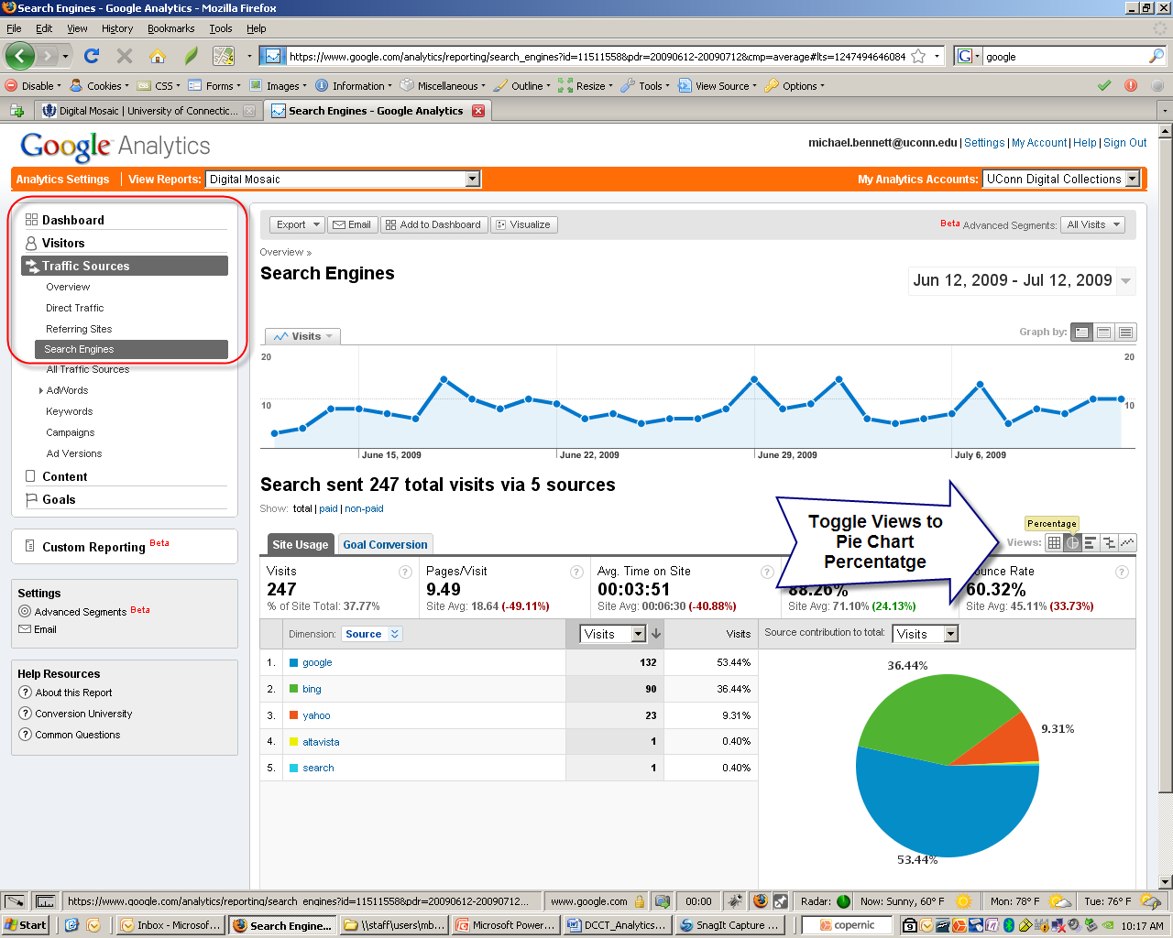
Q 12: What percentage of total Digital Mosaic traffic in the past month has arrived from Google & other Search Engines?

Slide 21
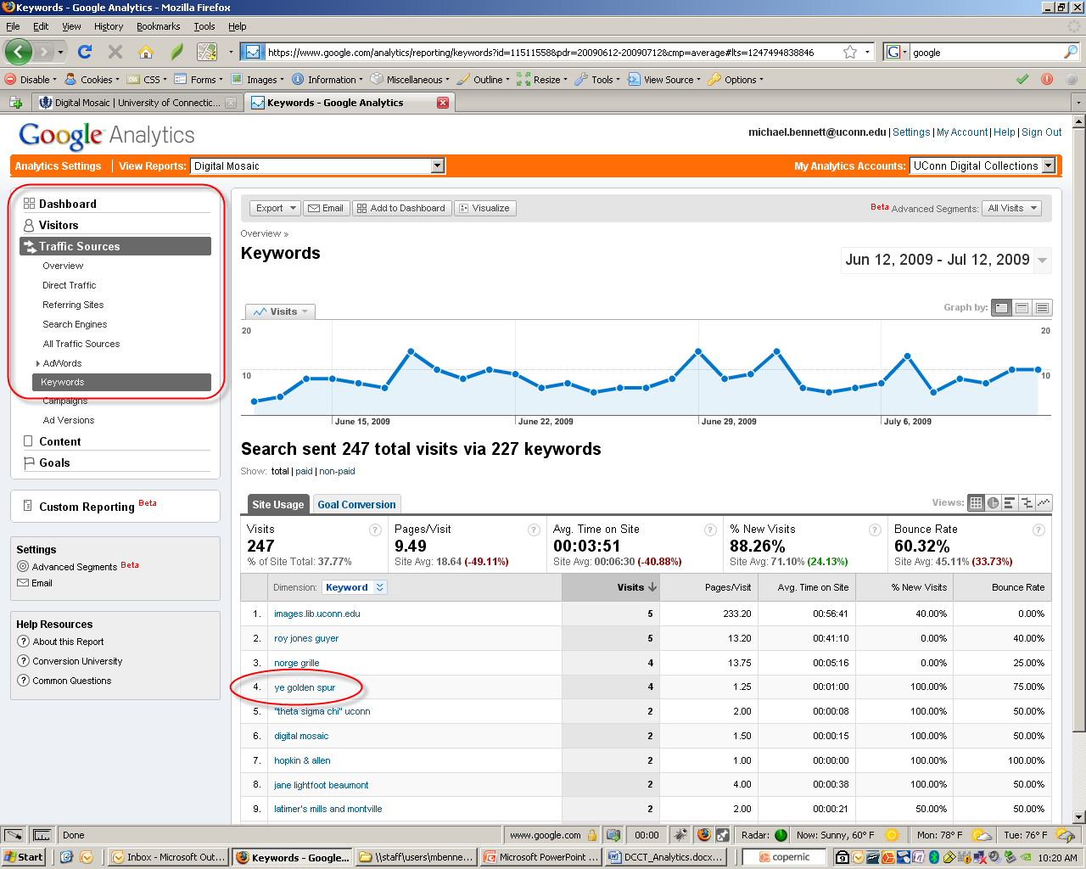
Q 13: What keywords do people use to find digital objects in Digital Mosaic?

Slide 22
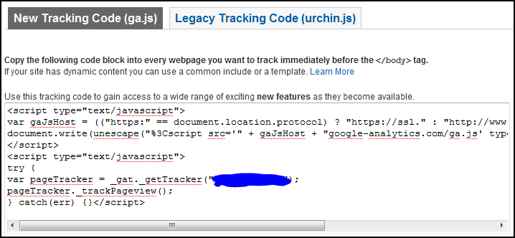
FAQ: How well does Google Analytics filter out bots?
Remember, GA runs through javascript…
Most bots like Google’s own, googlebot, do not execute javascript tags. This means they do not trigger your web analytics’ own javascript and don’t corrupt your data. Google Analytics Help: Questions, Answers, Tips, Ideas, Suggestions | Occam's Razor by Avinash Kaushik, http://www.kaushik.net/avinash/2008/07/google-analytics-help-questions-answers-tips-ideas-suggestions.html (retrieved 8.2.09).

Slide 23
Contact Information
Michael J. Bennett
Digital Projects Librarian & IR Coordinator
michael.bennett@uconn.edu
University of Connecticut Libraries
Storrs, CT

